Slide 1
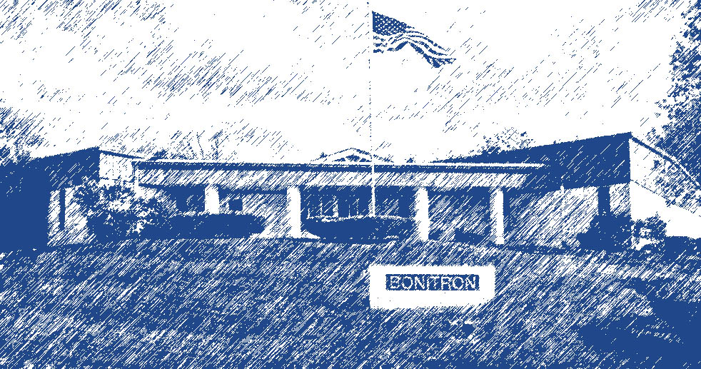
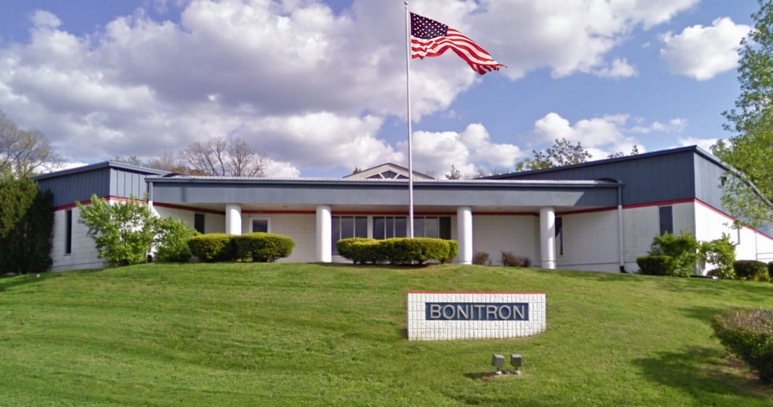
Marine Drive Applications
Solutions for AC Drives
20140307
Notes:
Welcome.

Slide 2
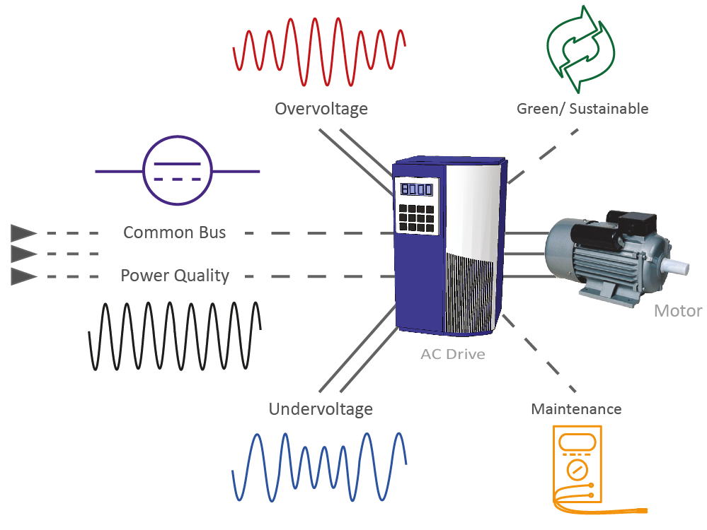
Marine Drive Applications
Drive Applications
Where are drives used?
Bonitron
How can we fix the problems?
Products
What problems are present with drive process?
Overvoltage
Common Bus
Undervoltage
Maintenance
Discussion

Slide 3
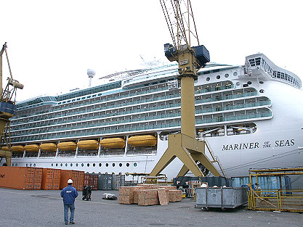
Marine Drive Applications
Voyager, Freedom, & Eagle Class
200 – 300 ventilation drives
12 – 18 winch drives
6 – 8 machine room drives for pumps & fans
4 drives for swimming pool filling pumps
Cruise Ships
Notes:
Example of how many drives are on a ship

Slide 4
Marine Drive Applications
Supply Ships
Drilling Rigs
Cruise Ships
Tankers
Ferries
Military
Barges
Fishing / Factory
Drive Applications
Fans
Pumps
Winches
Cranes
Propulsion
Cargo Ramps
Deck Lids
Drilling Rigs
Conveyors
Centrifuges
HVAC
Ships

Slide 5
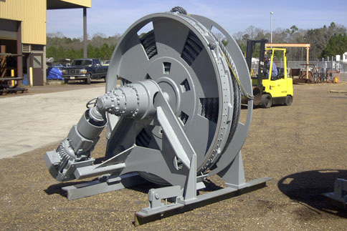
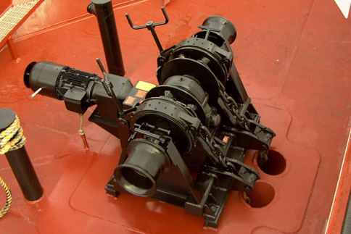
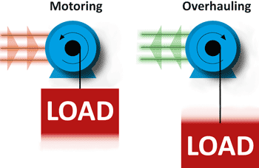
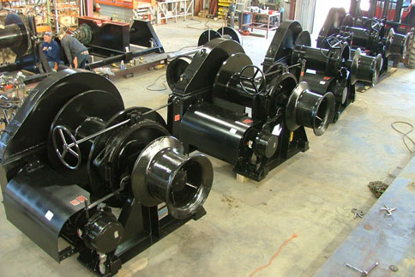
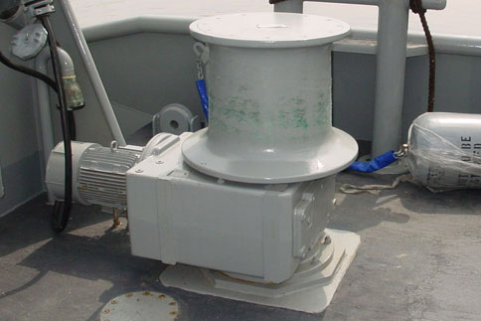
Winches
Typical winch motors are from 15 HP to 75 HP.
Some have multiple motors and drives on one bus.
Anchor Winch
Windlass
Mooring Winch
Capstan

Slide 6
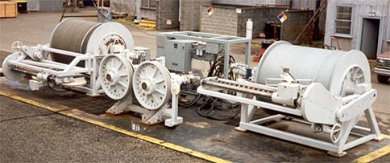
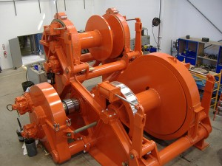
Winches
Problems
DC voltage rises when load is lowered (Drive holding back to prevent free fall)
Overvoltage can cause drive faults or require a drive to slow process to compensate
Limited space in drive control room. Transistor/resistor generates heat, requiring extra cooling
Excess DC power generated from braking drives is dissipated in transistor/resistor
Traction Winch System
Recovery Winch

Slide 7
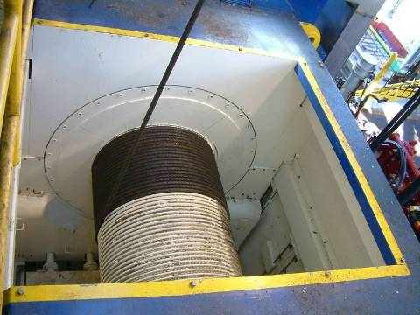
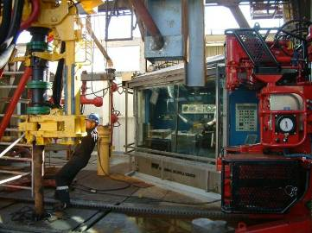
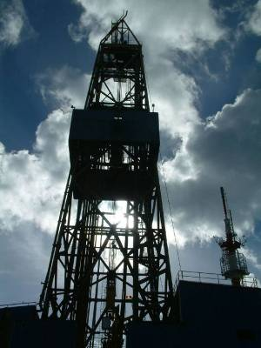
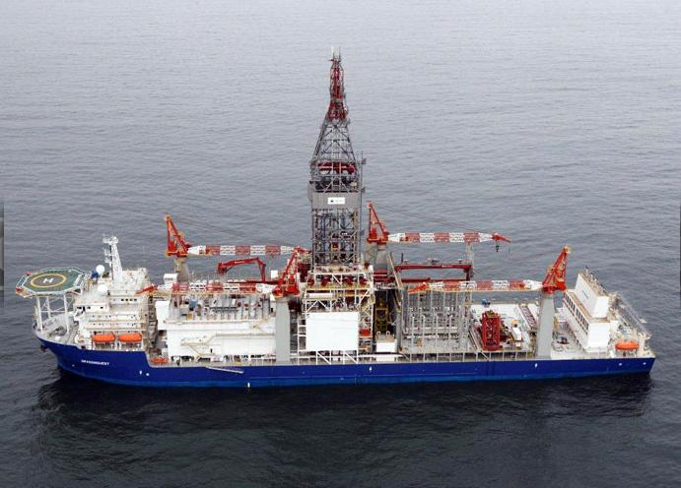
Draw-works & Top Drives
Draw-works
The faster the draw-works can move, the better
The drill string is moved rapidly and stopped quickly before hitting the bottom of the hole
Top Drive
Drill strings can be thousands of feet in length
It is common for one end of the string to be spinning at a different speed than the other end
Notes:
Time is money in the oil industry. The faster the drawworks lowers the drill string back into the borehole after adding an extension, the better. The drill string is dropped and then stopped rapidly before hitting the bottom. This rapid deceleration requires drive overvoltage protection, commonly in the form of a Braking Transistor and Resistor.
A Top Drive or Rotary Table spins the drill string. Drill strings can be thousands of feet in length, so it is common for one end of the string to be spinning faster or slower than the other end. Overvoltage protection on the top drive or rotary table is necessary in these cases to control torque on the drill string.

Slide 8
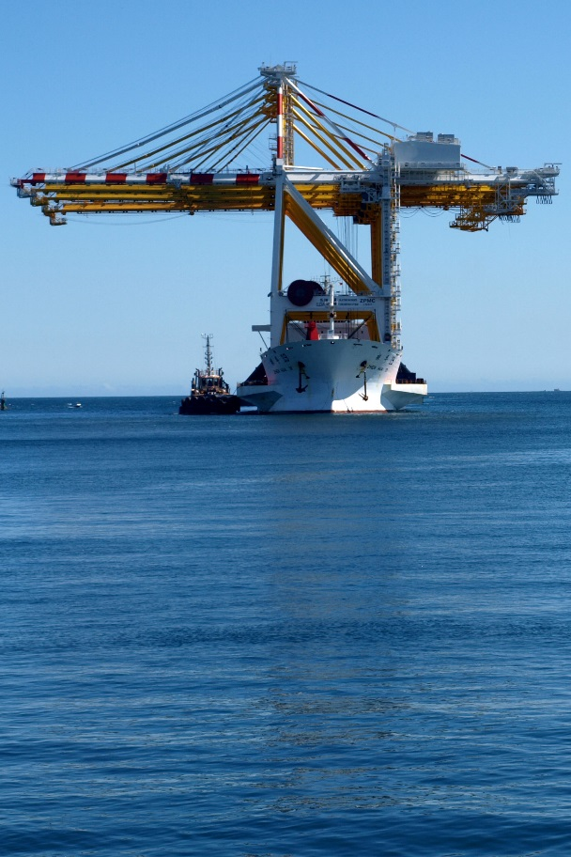
Draw-works & Top Drives
Problems
Rapid braking of the draw works generates excess DC power, causing the drive to fault or requiring an extended braking period
Excess DC power generated from braking drives is dissipated in transistor/resistor
The ends of a drill string can be rotating at different speeds, creating torque on the drill string

Slide 9
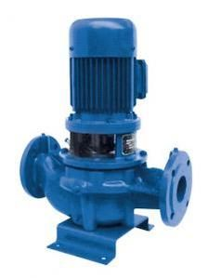
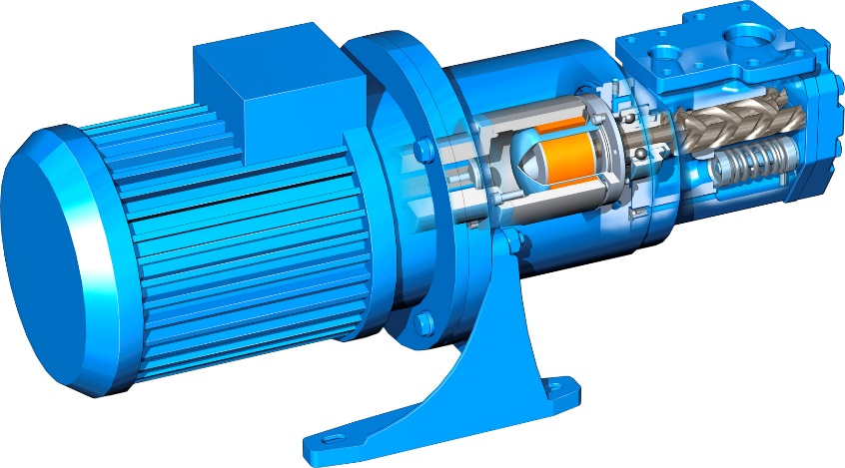
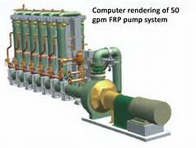
Pumps
Ships house many types of pumps, including mud pumps and process cooling pumps.
Pumps may benefit from using a UPD to eliminate nuisance trips which can be frequent on ship power systems.

Slide 10
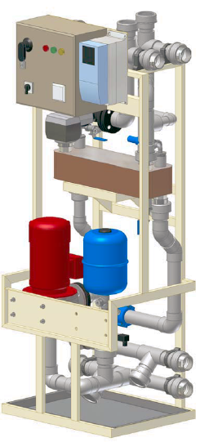
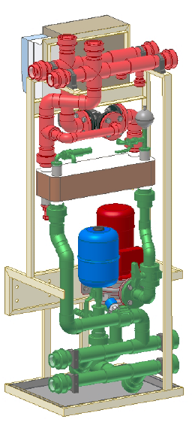
Pumps
Problems
Smaller HP pumps require UPDs to eliminate nuisance drive trips which are frequent on ship grid systems
Cooling is critical to keep propulsion drives running and efficient and prevent drive trips
Systems with multiple motors and drives require more wiring and components and ships have limited space for extra components

Slide 11
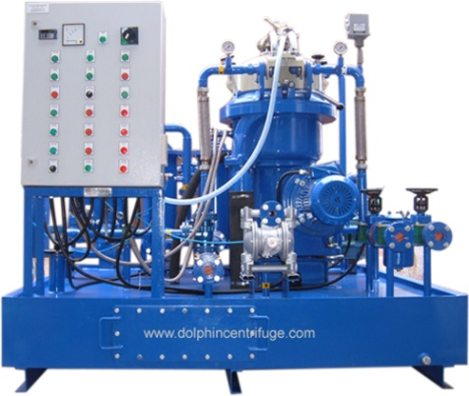
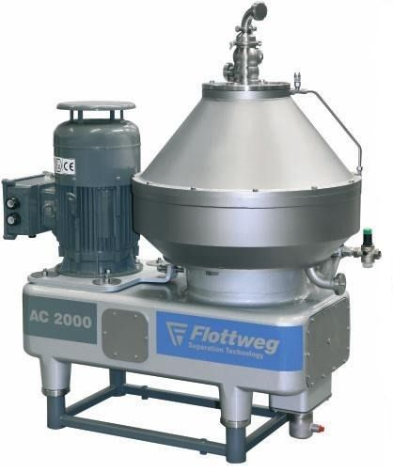
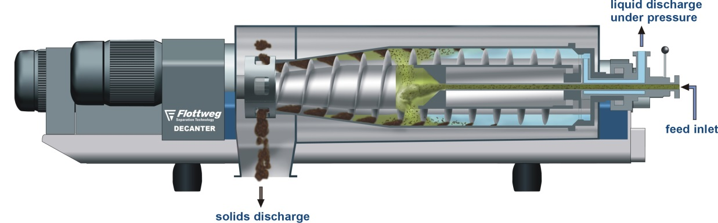
Centrifuges
Centrifuges on ships are generally used in sludge drying or food processing on fishing vessels.
Removing undesirable liquid such as water from useful liquids such as fuel or hydraulic or lube oil is another common marine application of centrifuges.
Notes:
Centrifuges on ships are generally used in sludge drying or food processing on fishing vessels.
Removing undesirable liquid such as water from useful liquids such as fuel or hydraulic or lube oil is another common marine application of centrifuges.

Slide 12
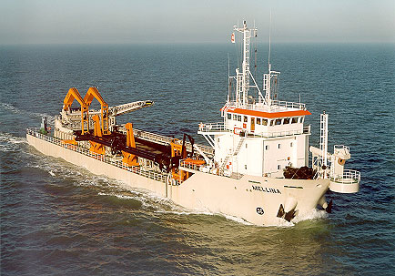
Centrifuges
Problems
Can take hours to coast to stop
Drive speed decreased to slow/stop centrifuge
Electricity created from a stopping centrifuge is dissipated when it can be used to power/start other centrifuges
Mechanical energy converted to electrical energy and causes DC voltage to rise

Slide 13
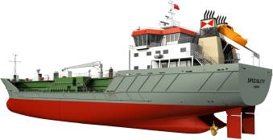
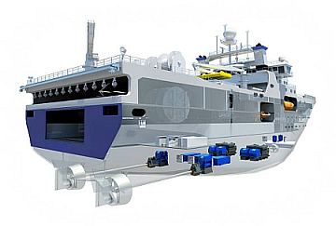
Propulsion & Thrusters
Diesel-electric propulsion are used on tugboats, offshore/platform vessels, and workboats for dynamic positioning.
Electric motors and drives have a faster response time, allowing for quick changes in direction.

Slide 14

Propulsion & Thrusters
Problems
Side thrusters stop and change direction quickly, causing DC bus voltage to rise, causing drive trips
Transistor/Resistor braking generates heat, requiring extra cooling in small drive control room
Multiple separate thrusters and drives in one system require more wiring and components

Slide 15
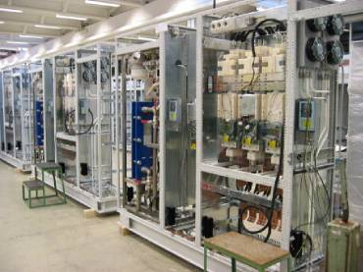
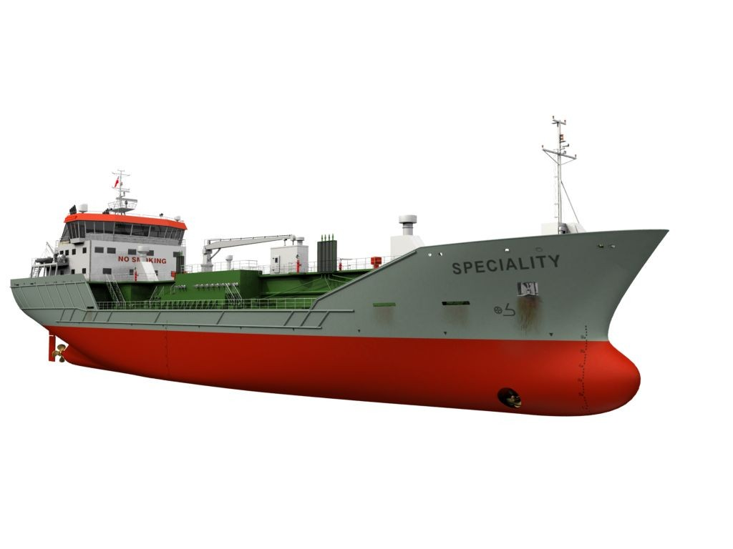
Propulsion & Thrusters
AC Drive Propulsion System
Fixed Propellers
Use Braking Transistors

Slide 16
Bonitron Solutions
Drive Applications
Where are drives used?
Bonitron
How can we fix the problems?
Products
What problems are present with drive process?
Overvoltage
Common Bus
Undervoltage
Maintenance
Discussion

Slide 17
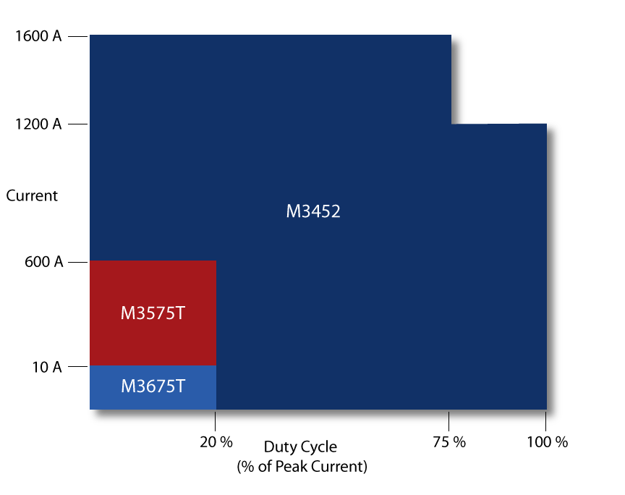
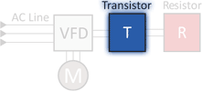
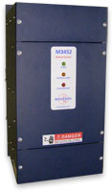
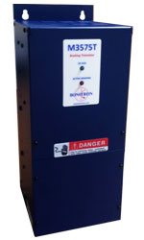
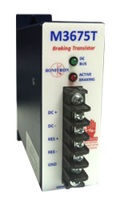
Overvoltage Solutions
Transistors/Choppers
17
Notes:
Bonitron has 3 series of braking transistors. Act as switch that allows overvoltage to flow into resistor to prevent drive faults.
Example – AB drive OV fault 810VDC, Bonitron Transistor turns on at 750VDC
M3452 – Heavy Duty Choppers
High duty
75 – 1600 A
230 – 690 VAC
Networking Options
M3575T – Standard Duty Choppers
20% duty
10 – 600 A
230 – 460 VAC
M3675T Braking Transistor
Up to 10A
115 – 480VAC

Slide 18
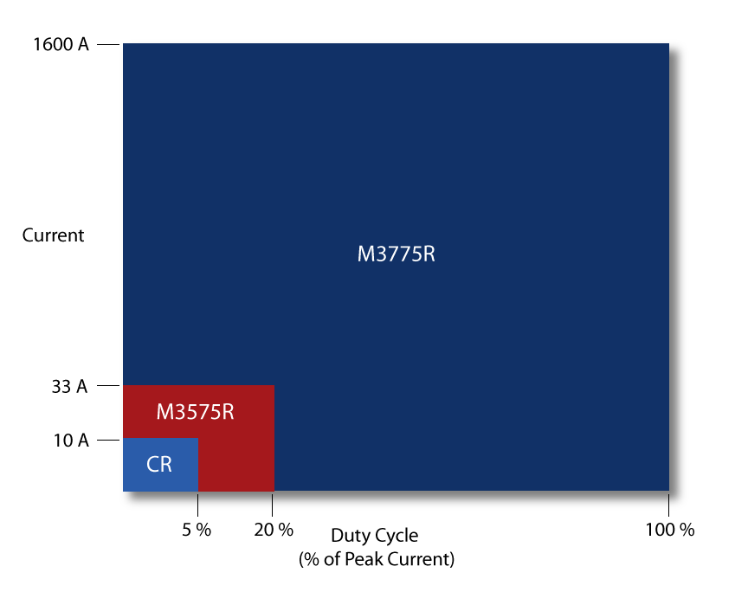
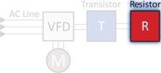
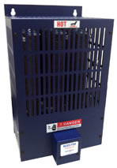
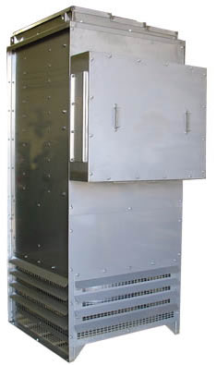
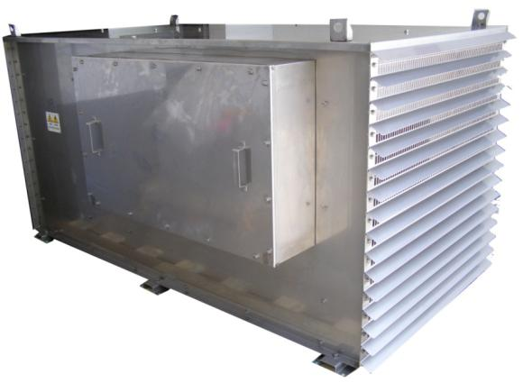
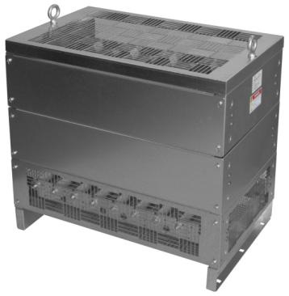
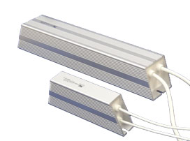
Overvoltage Solutions
Resistors
18
Notes:
M3575R
Up to 33A
6 or 20% Duty
M3775R
Up to 1600+ Amps
10, 50, and 100% Duty
Convection or Fan Cooled
Custom Available
Convection or fan cooled
NEMA-3R
Stainless steel
Multiple elements in one enclosure for multiple drives or choppers

Slide 19
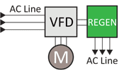
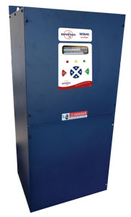
Overvoltage Solutions
Line Regen
Great return on investment
Regenerative energy returned to AC line reduces utility power usage
Product Highlights
208 - 600VAC support with 50/60Hz auto select
Integrated filtering and transient suppression
> 99% efficient
Digital Display with event and usage logging
20, 30, 50, 100 Amp units
150% overload for 60 seconds
Notes:
19
The Bonitron Line Regen takes the place of a braking transistor and resistor. Instead of dumping excess energy into a resistor, the Bonitron Line Regen returns that energy back to the AC line. This reduces room cooling requirements and has a smaller footprint.

Slide 20
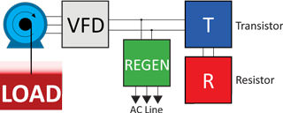

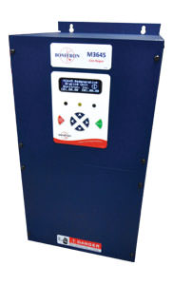

Overvoltage Solutions
Transistor / Resistor
Line Regen
Both
Heat generated
Return on Investment
Simple, low-cost install near drive
Regen efficiency
Large Transistor/Resistor for peak or surge power
Locate outside or adjust cooling
Added install cost (conduit, wiring, etc)
Resistor
Regen
Transistor
Notes:
Bonitron offers 3 methods to protect drives from Overvoltage faults:
Transistor and Resistor
Line Regen
Or Both
Transistor/Resistor (Dynamic Braking)
The dynamic brake method typically has a lower up front cost, but heat generated by resistors can increase cost two way. If the resistors are indoors, added cooling capacity may be required for the room. Large resistor banks may be kept outside, far from the drive, but this results in more wiring and conduit cost. Resistors also need time to cool down after a braking cycle. Regen units are rated for continuous use and so are typically a better choice for high duty applications such as cranes and hoists where utility power is used.
Line Regeneration
Line regen solutions have many advantages. First, because the unit does not generate high levels of heat (99% efficient), it can be integrated into the drive cabinet. Second, the unit can run continuously without the need of a cool down period. Third, the lack of heat generation allows its use in environments where there might be flammable materials such as feathers, dust, or wood. The regen also boost energy efficiency as it puts electricity back into the AC line where it can be used by other equipment, considerably reducing the demand from the utility.
Both
A regen is most effective for frequent or continuous braking up to 450A, while a transistor/resistor is more suited to higher peak loads for shorter durations. If necessary, transistor/resistor and regen units can be used together for a more efficient solution, where the regen handles continuous braking needs and the dynamic brake activates when the regens's capacity is surpassed.

Slide 21
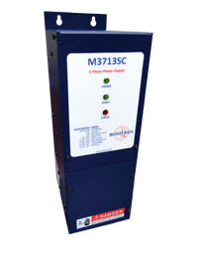
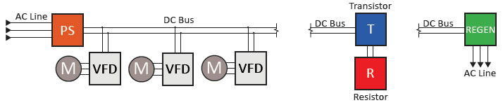
Common Bus Solutions
Common Bus Power Supply
AC in. DC out
Drives powered via DC +/-
Drives share power
Single or 3-phase AC input
Notes:
Common Bus Power Supply
Using a common bus power supply reduces the amount of wiring and components in a system, resulting in a reduction of maintenance and footprint of the system. In a system with multiple motors, some motors may be regenerating while others are motoring. The common bus allows the regenerating drives to share power with the motoring drives, thus reducing the amount of power needed from the grid. If the drives are creating a net surplus of energy, a single line regen or braking unit can be installed to dissipate the excess energy.

Slide 22
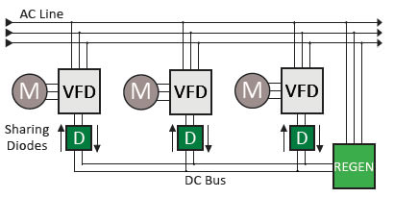
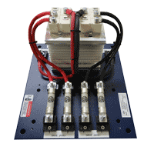
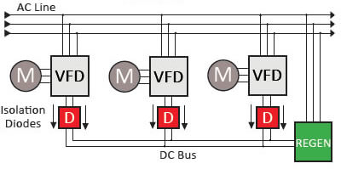
Common Bus Solutions
Sharing Diodes
Isolation Diodes
Drives powered via AC +/-
Drives powered via AC +/-
Drives share power
Drives isolated. Do not share power
Notes:
Common Bus Sharing Diodes M3345CBM
If drives on the AC line are connected by a DC bus, circulating currents can be created that might cause drive faults. The sharing diodes allow a two way flow of power to and from drives enabling them to share power between their DC busses while preventing circulating currents. The two-way flow allows the drives to share power with each other and use a common braking, regen, or UPD.
Common Bus Isolation Diodes M3345D, M3460D
Unlike the sharing diodes, the isolation diodes allow only a one-way flow of power and do not allow drives to share power with each other, completely isolating the drives and preventing circulating currents. The isolation diodes allow multiple drives to be connected on the DC bus so that they can share one braking unit, regen, or UPD. The M3345D allows an outward flow of power from the connected drives to be dissipated by a braking or regen unit. The M3460D allows inward flow of power so that one UPD can power all of the drives connected to the DC bus.

Slide 23

Uninterruptible Power for Drives
UPD
Critical applications
Power drive during power sag or outage
Sold as complete systems with cabinet and disconnects or as components to integrate
Voltage Regulator
Charger
Energy Storage
Discharger
Notes:
Bonitron UPD has two main types. The first is UPD
UPD Lite
Some crane processes may not require uninterruptible power, but require enough power to shut down safely or reset the equipment to a default position during an outage. For these low speed applications the UPD can be undersized to 10-20% of the motor HP, greatly reducing the cost. This is possible because:
Power = Speed x Torque
So theoretically, if you run at one half of the regular speed with the same torque, it will use half of the regular power. Contact Bonitron to learn more about the potential of UPD Lite for your application.

Slide 24


Uninterruptible Power for Drives
Sags
No energy storage necessary
Provides full-load power for up to 2 seconds for:
50% 3-phase sags
1-phase sag to 0v
Voltage Regulator

Slide 25


Uninterruptible Power for Drives
Short Term Outage
2-second, 100% 3-phase outages
Long lifespan
Electrolytic or ultracapacitor energy storage
Capacitor Systems
Voltage Regulator
Charger
Capacitor
Discharger

Slide 26

Uninterruptible Power for Drives
Long Term Outage
4-minutes, 100% 3-phase outages
Ideal for dark starts or to maintain process before generator starts
Battery energy storage
Battery Systems
Voltage Regulator
Charger
Battery

Slide 27

Typical UPS
UPS Disadvantages

Slide 28

Uninterruptible Power for Drives

Slide 29

Maintenance Solutions
Capacitor Maintenance
Capacitor Formers
Form capacitors
Benchtop power supply
Capacitor Testers
Measure capacitance and ESR to determine when end of life is reached
Test drives left in storage (Drives contain capacitors)

Slide 30
Discussion
Drive Applications
Where are drives used?
Bonitron
How can we fix the problems?
Products
What problems are present with drive process?
Overvoltage
Common Bus
Undervoltage
Maintenance
Discussion

Slide 31


Discussion
Shipboard
Target Customers
Overvoltage
Common Bus
Maintenance
Solutions & Applications
Undervoltage
All Ports
Shipbuilders
OEM Marine

