Slide 1
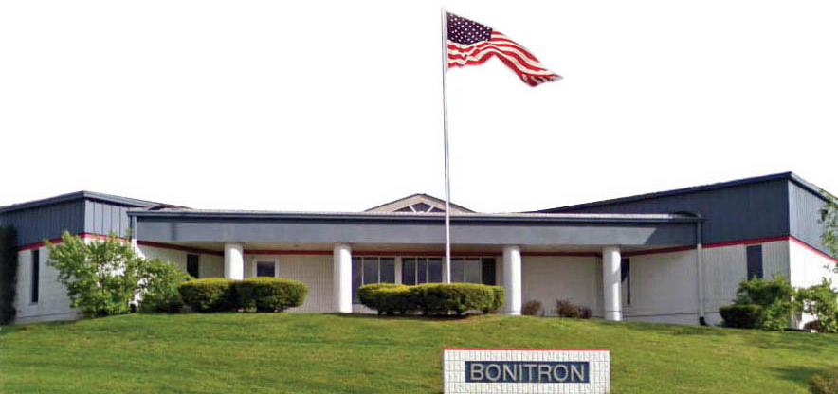
Bonitron, Inc.
If you have VFDs, you’ll need some of these…
20140120
Notes:
Welcome.

Slide 2
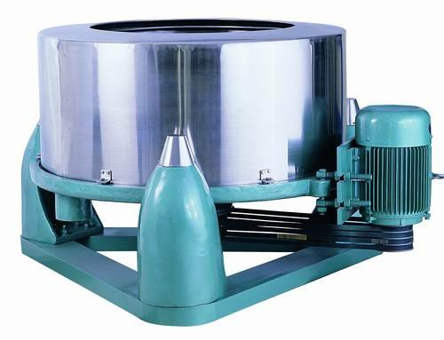
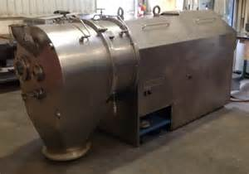
Centrifuges
Regenerative Energy Created by Rapid Decelerations and multiple VFDs overhauling within the process
DC Bus Over-voltage in Centrifuges
Centrifuges are used in many processes where particles or material is separated from a solution and waste or non-usable material is discharged from the centrifuge so usable material can be recycled
Centrifuge motors that run the process stages are controlled by VFDs
During the centrifuge process the VFD can be required to go through several rapid motion changes and overhauling conditions, creating regenerative energy or a VFD DC bus over-voltage condition that can trip drives
Particle Separation Accomplished by High Velocity Spin

Slide 3
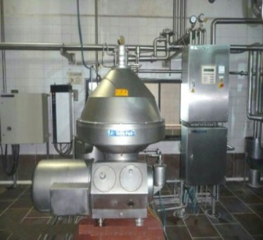
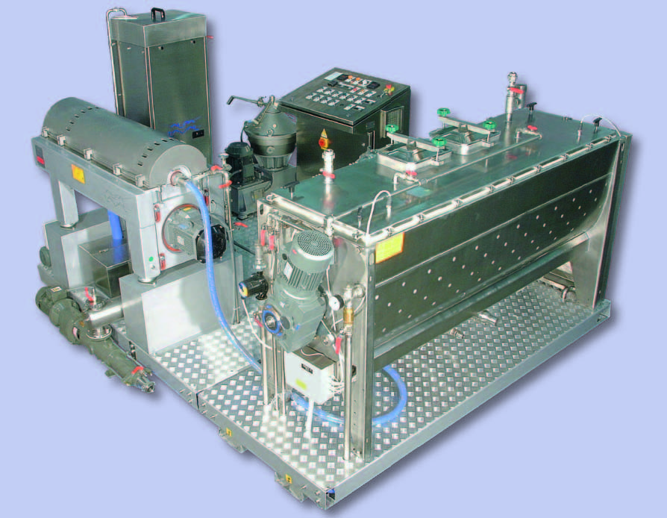

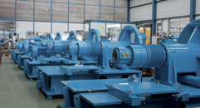
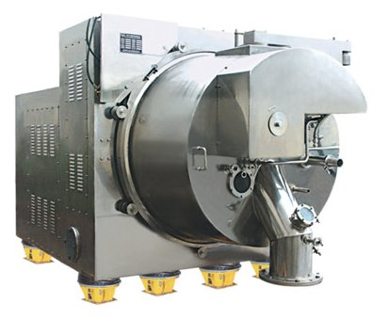
Centrifuge Types
Two Main Types of Processing That Use Centrifuges
Batch Processing
Particle Separation or mixing is accomplished by high velocity spin.
Regenerative Energy Created by Rapid Deceleration During the Stages and overhauling drives in the process
Several Process Stages During Cycle
Continuous Processing
Process that has material feed to centrifuge continuously
Drive DC Bus Over-voltage is created by the rotational inertia during decel of the centrifuge
Can take long periods to coast to stop creating long periods of nonproductively between batches
Regenerative Energy is Created due to Rapid Decel between batches
Alpha Laval Olive Oil
Flottweg Beverage
Ferrum Shipment
Heinkle Waste Water
CES

Slide 4
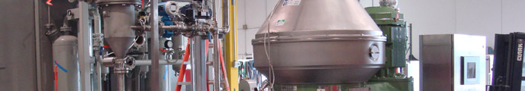
Batch Process Centrifuge
Batch Processing and Regenerative Energy
Batch processing is where particles or material is separated from a solution and waste or non-usable material is discharged from the centrifuge for a single batch.
Upon completion of the process the batch is collected in a holding tank and the VFD is required to preform a high speed stop that exceeds the time constant of a braking resistor.
Centrifuge motors that run the process are controlled by VFDs that must preform at high duty cycles during deceleration .
100% braking duty resistors must be specified even though the process does not present constant braking duty

Slide 5
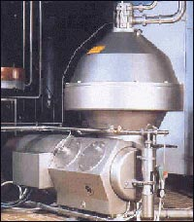
Food & Beverage
Centrifuges have been used in the beverage industry for almost a century. They perform a wide variety of functions, including:
Clarification of raw and depectinized fruit juices; cloudy juices and other beverages.
Clarification of high-solids juice and other beverages.
Citrus juice clarification and depulping.
Essential oil recovery from citrus fruits such as oranges, lemons, tangerines and limes.
First stage peel oil concentration.
Second stage peel oil polishing.
Dairy Centrifuges are used in milk clarification, hot milk separation, whey clarification, cold milk separation, whey separation, and bactofugation

Slide 6

Batch Centrifuge

Slide 7
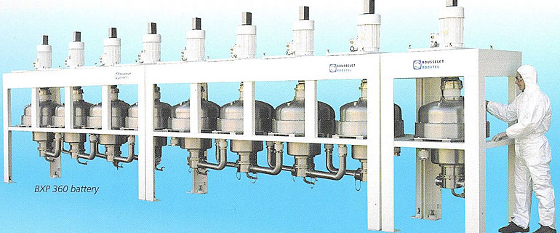
Common Bus Batch Process Centrifuges
Multiple VFDs Can Be Common Bused for Cost Effectiveness
Batch Processing
Single motor and VFD for a single centrifuge
Common bus and regenerative energy solution must be sized to cover all the VFDs on the common bus
VFDs can be common bussed to use one regen or brake for Multiple Centrifuges
Energy created from a stopping centrifuge can be used to power/start other centrifuges
Several batch process VFDs could be common bussed

Slide 8

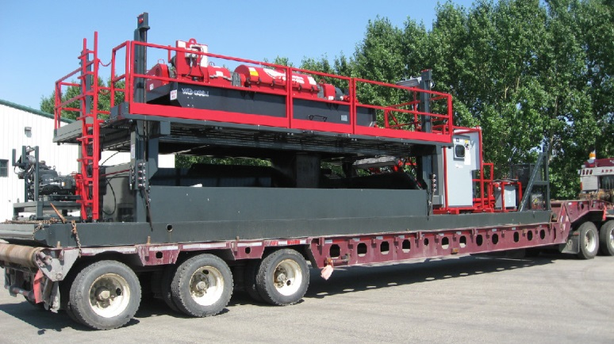
Gold Processing / Separating
Unique drive system: The backdrive motor acts as a generator and generates power back to the DC bus, a result of resistance to flow from the fluid being moved through the centrifuge and the common solids being augered out. The power is then being used by the entire system.
The combination of our high efficiency motors, exhane Polyrad power cords and backdrive regeneration system reduce (total) amperage draw from the electrical source. This gives our system added economic and mechanical efficiency.

Slide 9
Batch Centrifuge Applications
Oil Refining
Chemical Processing
Food Processing
Pharmaceuticals
Extraction
Compound Separation
Separating Compounds
Separating different viscosities

Slide 10

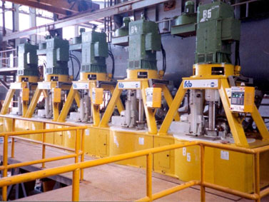
Batch Centrifuge Applications
Batch Centrifuges in Sugar Mills
Fives Cail centrifugals handle more than 25 million metric tons of sugar every year worldwide, offering a complete range covering all applications : beet, cane and refining.
Fives, an industrial engineering Group, designs and supplies machines, process equipment and production lines for the world’s largest industrial groups in the aluminium, steel, glass, automotive, aerospace, logistics, cement and energy sectors.

Slide 11
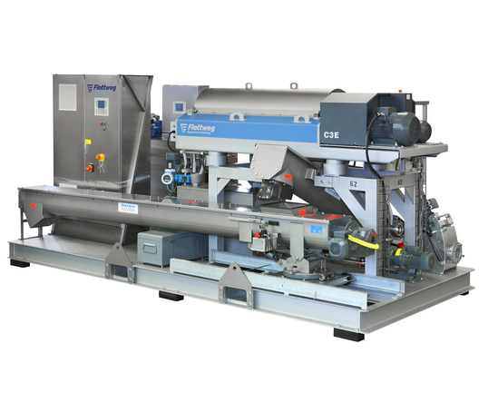
Decanter Centrifuge
Decanter centrifuges are used to extract (dewater) solid materials from liquids when they are mixed together in slurry. Decanter centrifuges are used in many industrial applications such as:
1. Oil /solids separation (oil well drilling, refining, de-watering)
2. Industrial and biological wastewater treatment
3. Food processing (olive oil, wine, fruit juice)
4. Fish processing (fish meal, fish oil)
5. Chemical slurry
A main drive motor supplies power to turn the centrifuge. AC drives are commonly used to power the main drive motor. There are several different types of decanter centrifuges, such as: Vertical, horizontal, or scroll (conveyor)

Slide 12
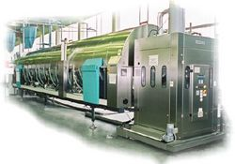
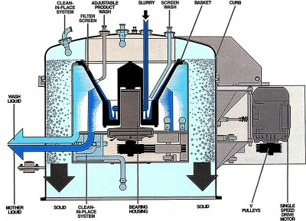
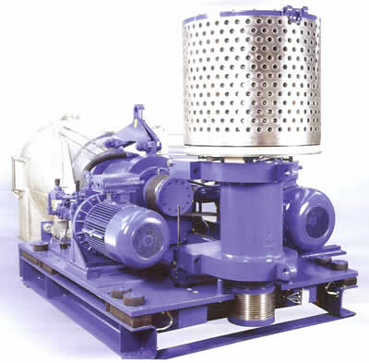
Continuous Process Centrifuge
Continuous Process
100% Regenerative
Augur regenerates
The drum spins faster than the augur
Generally 50-100Hp VFDs are used

Slide 13
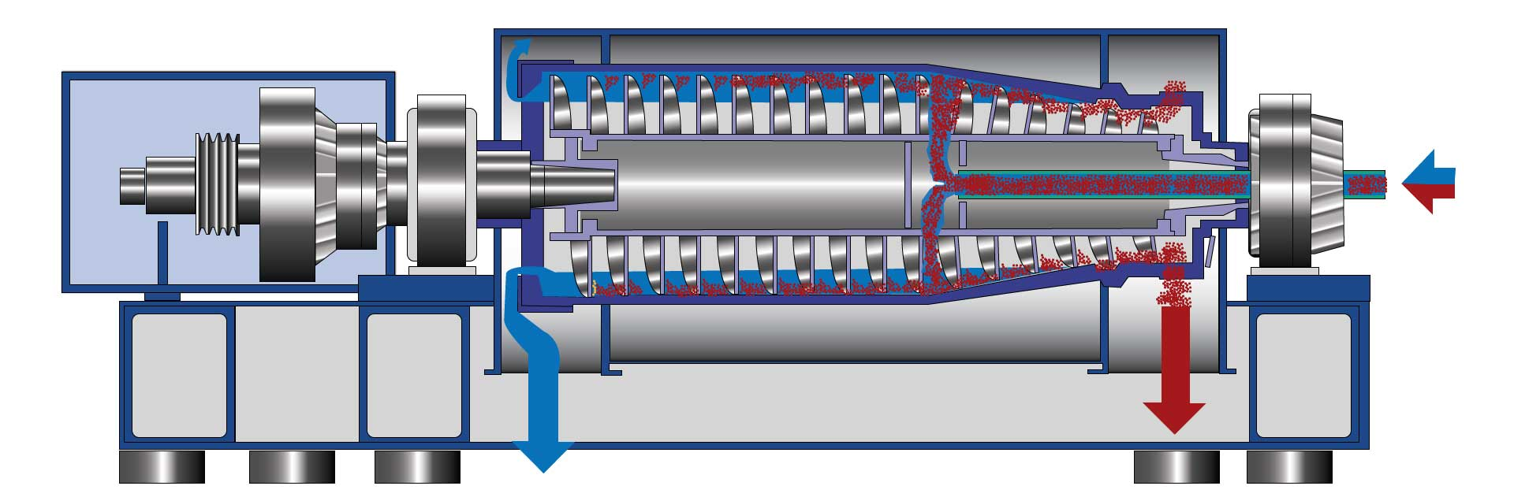
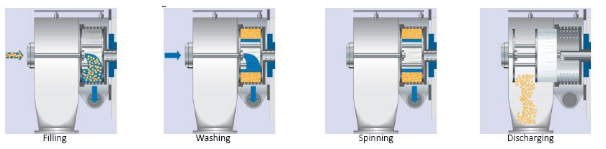
Continuous Process “Pusher” Centrifuge
Drum
Auger
Notes:
Continuous Process Industrial centrifuges are used in filtering applications in most cases. The slurry is fed continuously to the product acceleration disc via the filling pipe. During the filling stage the waste water solution is moved through the drum while spinning the heavier waste particles to the perimeter.
During washing stage the and passes out of the centrifuge.
Heavier particles build up into a sludge or “cake” until it is pushed to be scraped out of the centrifuge. Automated removal of solids adds additional motors to the application but dramatically improves productivity.
The frequently used decanter centrifuge uses drives and motors on the infeed pump, main bowl, and screw conveyor which pulls solids out of the centrifuge. Centrifuges have very high inertia yet require high operational RPM’s. The combination is a challenging application for electric motors which want to pull 800% or more current until they reach full speed. Traditional across-the-line starting will generally not work for this application.
Look for decanter centrifuges where drives on main bowl and screw conveyor can share energy over a common DC bus for maximum energy savings.

Slide 14
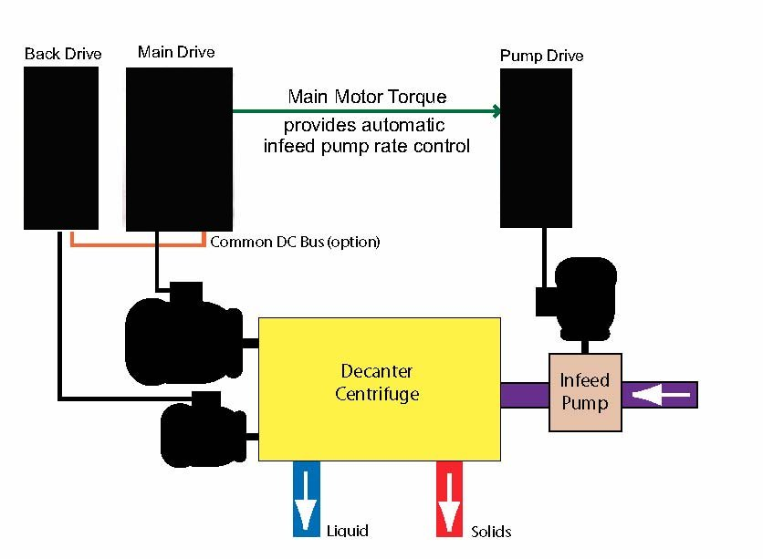
Continuous Centrifuge
The Continuous Process
100% Regenerative
Augur regenerates
The drum spins faster than the augur
Generally 50-100Hp VFDs are used

Slide 15
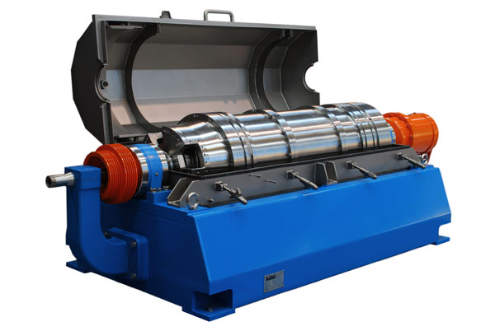
Continuous Process Centrifuge Applications
Water/Wastewater
Separating Waste From Solutions
Notes:
Horizontal canter used in beverage

