Slide 1
Bonitron, Inc.
Dedicated to engineering quality industrial electronics since 1962!

Slide 2
Introduction
Introduction
Question and Answer
What are Bonitron Solutions?
Why sell Bonitron Solutions?

Slide 3
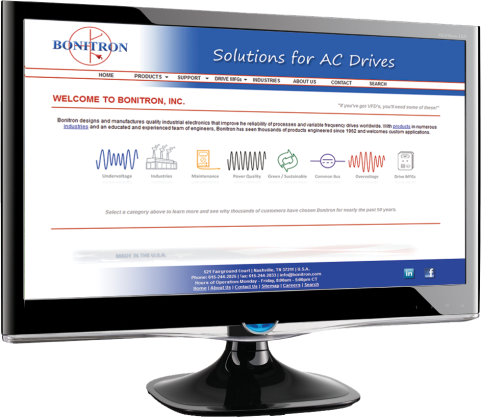
Introduction
1960s
Vanderbilt University
Government and Military R&D
Water/Wastewater
1970-80s
Digital AC Drive Control
1990s-Now
Work with large drive manufacturers to fill AC drive accessory voids
EI DuPont
Expanding into various energy management solutions
More reliable and precise than conventional analog
www.bonitron.com
Notes:
Bonitron was founded in 1962 and worked primarily as a contract engineering company and soon gained a strong reputation for customer service and superb quality.

Slide 4
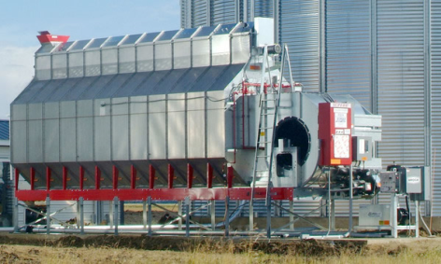
Recent Schneider Applications
Natural gas pumping
Turbines
Grain dryers
Pump jacks
Irrigation

Slide 5
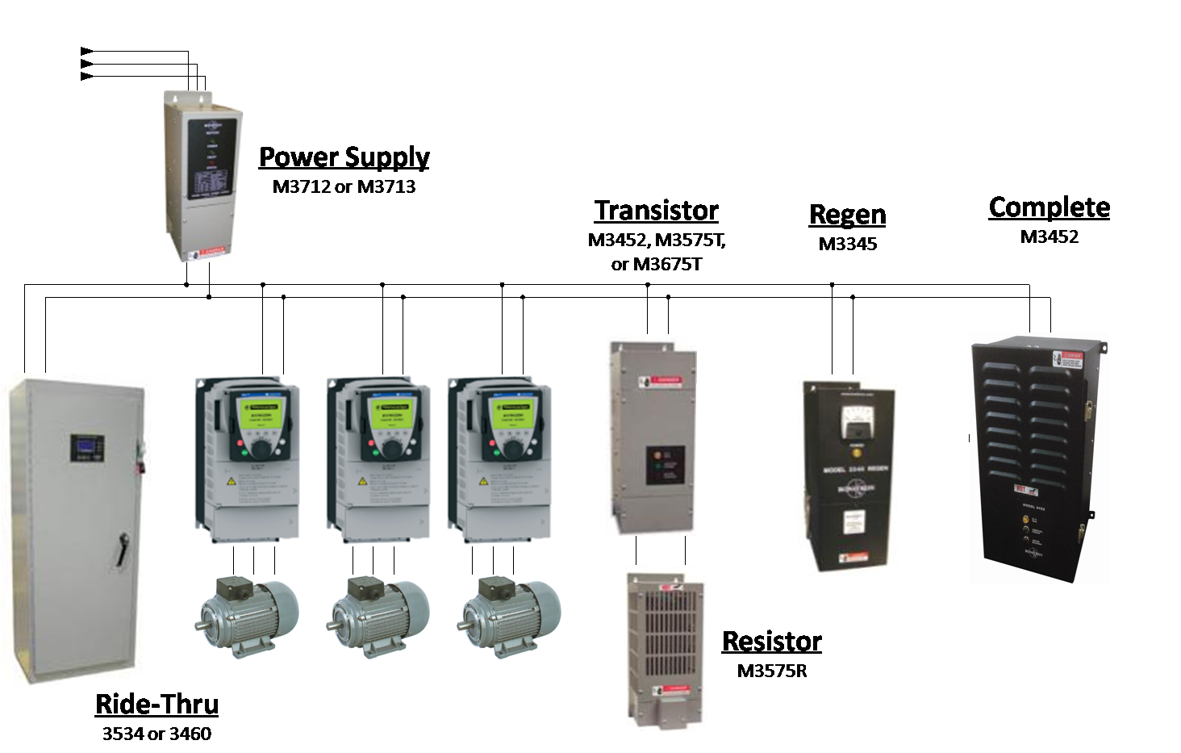
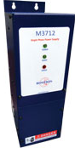
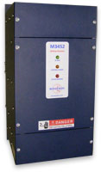
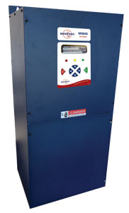
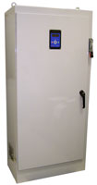
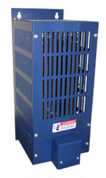
Bonitron Connectivity
Power Supply
M3712 or M3713
Transistor
M3675T, M3575T, M3452
Line Regen
M3645
Braking Kit
M3452 Complete
Resistor
M3575R or M3775R
Ride-Thru
S3534 or S3460 Series

Slide 6
Why Sell Bonitron Solutions?
Offer your customers a COMPLETE solution!
Introduction
What are Bonitron Solutions?
Question and Answer
Why sell Bonitron Solutions?

Slide 7
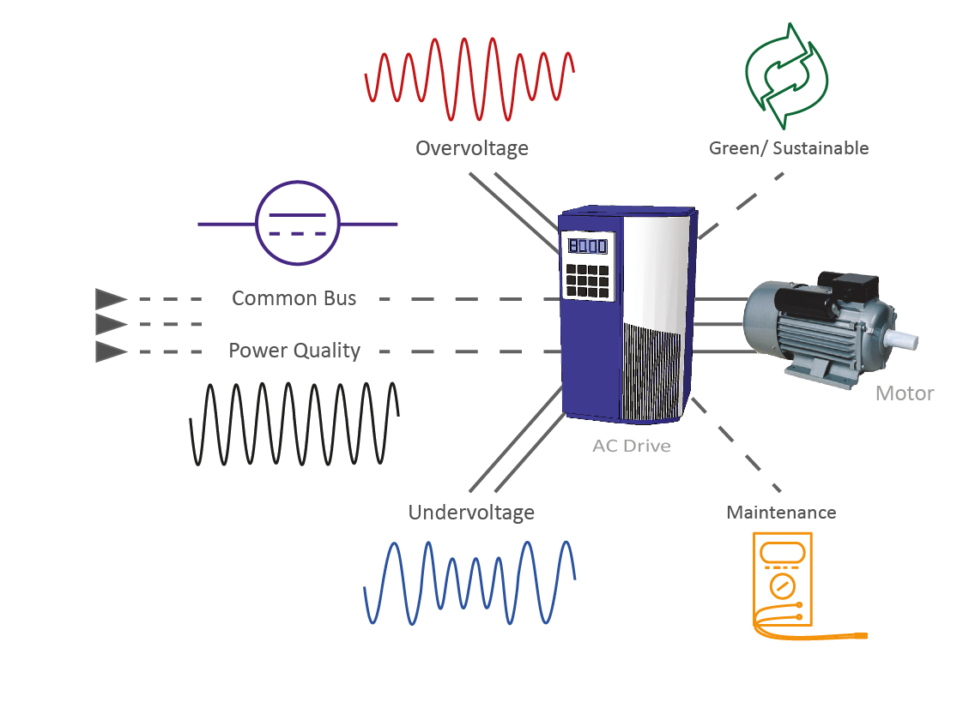
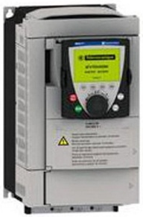
Why Sell Bonitron Solutions?
Fill in accessory gaps for missing options
Quicker lead times
Bonitron compliments ANY drive line
Local design AND engineering support
Simple DC bus connection
Choppers, resistors, power supplies, front-ends, etc.
Strong reputation in multiple industries
Support
100% load tested modules
Quality & Reliability
Versatility
Expose customers to alternative options - Greater customer interaction
Not an all or nothing sell – multiple component options
Better Lead times for Drive options than many drive manufacturers
Plus – You make money!
Notes:
Bonitron products center around supporting AC drives of any brand with a DC bus.
Selling Bonitron allows you to be versatile, enabling you to sell more options and components that allows greater customer interaction and limits all or nothing sales. Maintenance contracts for battery/storage systems are sometimes common as well.

Slide 8
Why Sell Bonitron Solutions?
Packaged Solution
Predefined Products
Proven Design
Fully Documented
Brand Labeling Optional
Sales Collateral for Applications and Products
UL Listed

Slide 9
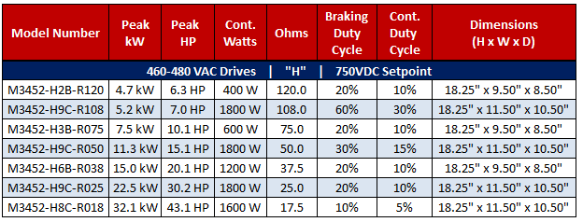
Why Sell Bonitron Solutions?
Product Descriptions
Manuals
Sales Literature
+ More!
Industries
Model Selection
www.bonitron.com
Online Support
Example: M3452 Complete

Slide 10
What are Bonitron Solutions?
Introduction
Question and Answer
What are Bonitron Solutions?
Why sell Bonitron Solutions?

Slide 11
What are Bonitron Solutions?
DC Bus Management
Notes:
Bonitron offers products in 6 main categories.
Universal usage with any drive manufacturer.
Design and engineering assistance for any application.

Slide 12
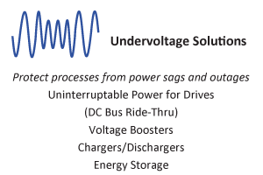
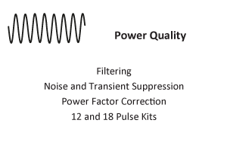
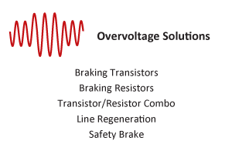
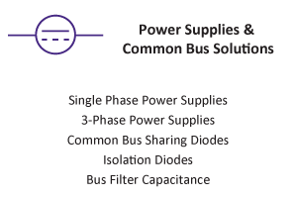
Undervoltage Solutions
Notes:
Bonitron offers products in 6 main categories.

Slide 13
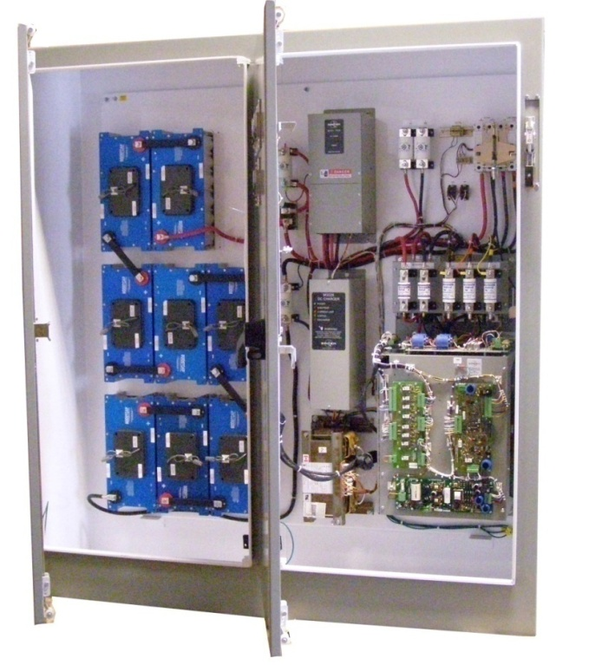
Undervoltage Solutions
Uninterruptible Power for Drives
Pre-Engineeered Solutions
Usable with all AC drive brands
Protection from sags to complete outages
Energy storage provided by Bonitron or third party
SEMI certified
Compliant to all outage standards
One Ride-Thru can support multiple VFDs
Integrated Safety Discharging
Notes:
Pictured above is a Ride-Thru system with ultracapacitor storage.

Slide 14
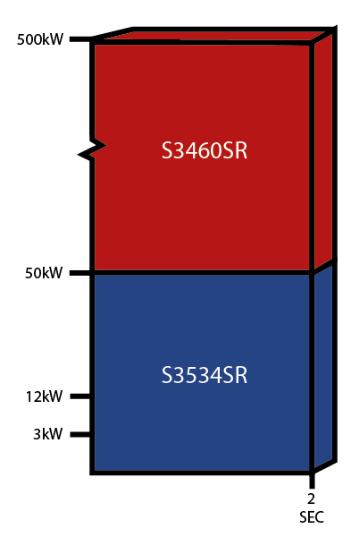
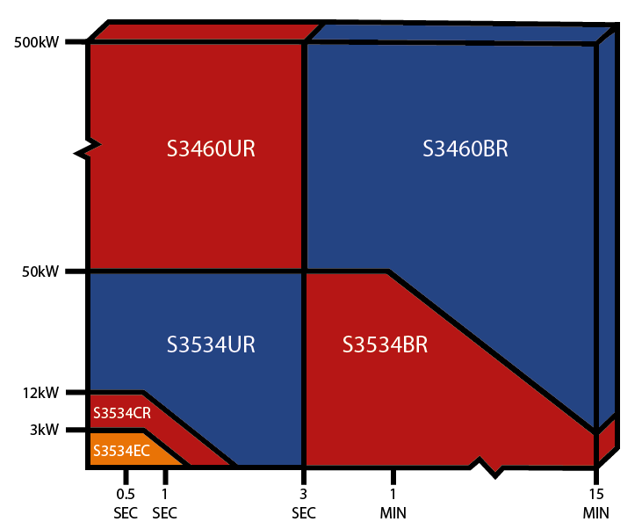
Undervoltage Solutions
Maintain DC Bus Voltage during an AC line sag or outage.
Outage Protection
Sag Protection
14

Slide 15
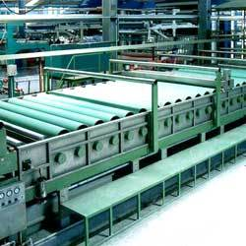
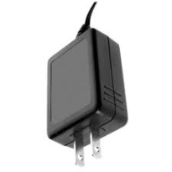
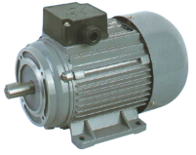
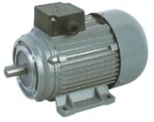
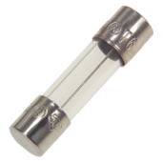
Undervoltage Solutions
Bypass
Drive + UPS is Less Reliable Due to Series Connection
Critical Process
UPS
Most Flywheels
Active Front End
AC Line Sag Corrector
Fuses
Drive + DC Bus Ride-Thru’s Parallel Configuration Has Greater Reliability
DC Bus Ride-Thru
Parallel Connection
= Increased Reliability

Slide 16
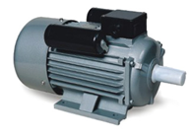
Undervoltage Solutions
AC Line
Discharger
M3628
AC Line
DC Link
Charger
M3528
Voltage Regulator
M3534R or M3460R
Energy Storage
Notes:
Typical configuration

Slide 17
Power Quality Solutions
Notes:
Bonitron offers products in 6 main categories.

Slide 18
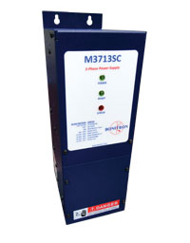
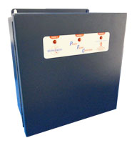
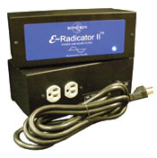
Power Quality Solutions
Noise/Transient Suppression
Reduce electrical noise
Reduce risk of damage to sensitive electronics
12 & 18 Pulse
6-Pulse blocks
M3713SC 3-Phase Power Supplies
Filtering
AC Line Filters
PWM to Sine Wave Filters
Power Factor Correction
Avoid costly power factor penalties

Slide 19
Overvoltage Solutions
Notes:
Bonitron offers products in 6 main categories

Slide 20
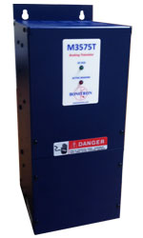
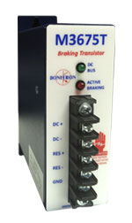
Overvoltage Solutions
Braking Transistors
M3452
M3575T
M3675T
M3575R or M3775 Resistor
20
Notes:
Bonitron has 3 series of braking transistors.

Slide 21
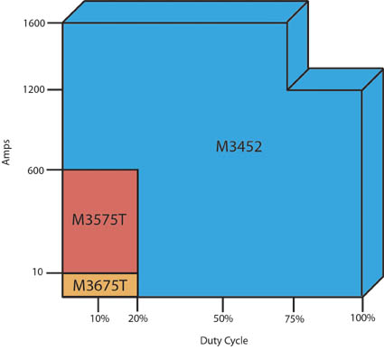
Overvoltage Solutions
M3575T – Standard Duty Choppers
20% duty
10 – 600 A
230 – 460 VAC
M3675T Braking Transistor
Up to 10A
115 – 480VAC
M3452 – Heavy Duty Choppers
High duty
75 – 1600 A
230 – 690 VAC
Networking Options
21
Notes:
Transistor ratings up to 1600Amps

Slide 22
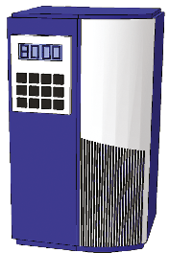
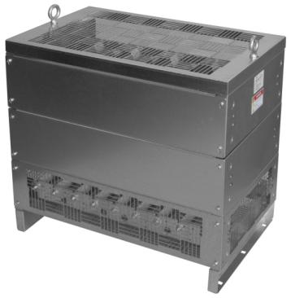
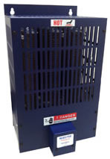
Overvoltage Solutions
Braking Resistors
M3575R or M3775R
22
Notes:
There’s no need to go anywhere but Bonitron for your braking solutions. You can get your transistor AND resistor from us. (Grid resistors and forced air).

Slide 23
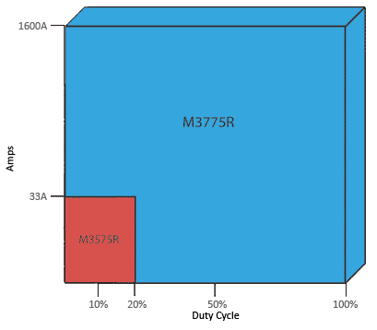
Overvoltage Solutions
M3575R
Up to 33A
6 or 20% Duty
M3775R
Up to 1600+ Amps
10, 50, and 100% Duty
Convection or Fan Cooled
Custom Available
Braking Resistors
23

Slide 24
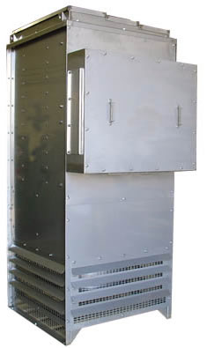
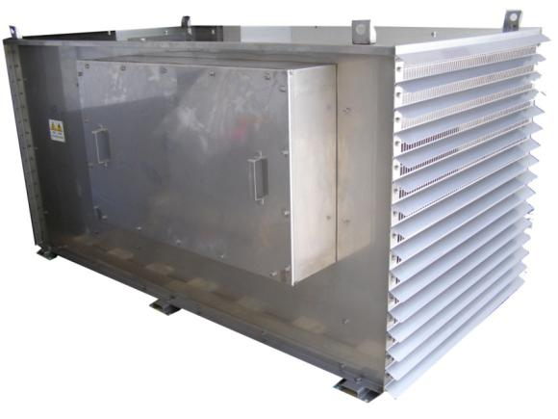
Overvoltage Solutions
Fan Cooled Units
Vertical or horizontal air flow
NEMA-3R Options
Stainless Steel Options
306
316
Etc.
Multiple Elements
for multiple drives or choppers
Custom Resistors
Notes:
Custom resistors are also available.

Slide 25
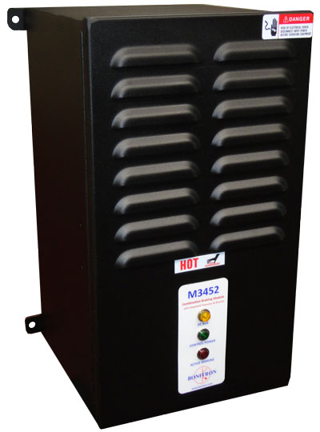
Overvoltage Solutions
Transistor/Resistor
M3452 Combination Unit
400 - 1800 Watts continuous
6 – 43 HP
230 - 575VAC
25
Notes:
The M3452 combination unit has a braking transistor and resistor in one, easy to install enclosure.

Slide 26
Overvoltage Solutions
Great return on investment
Regenerative energy returned to AC line reduces utility power usage
208 - 600VAC support with 50/60Hz auto select
Parallel for up to 300A peak / 200A continuous (Simply add another module - no setup)
Interactive Digital Display
Event logging
External fusing
Integrated filtering and transient suppression
>99% efficient
Product Highlights
Line Regen
Notes:
26
The Bonitron M3345 Line Regen takes the place of a braking transistor and resistor. Instead of dumping excess energy into a resistor, the Bonitron Line Regen returns that energy back to the AC line. This reduces room cooling requirements and has a smaller footprint.

Slide 27
Green/Sustainable Solutions
Notes:
Bonitron offers products in 6 main categories.

Slide 28
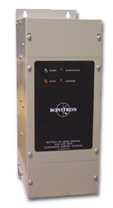
Green/Sustainable Solutions
Line Regeneration
Power Factor Correction
Avoid costly power factor penalties
Return regenerative energy back to the AC line instead of dissipating it as heat into a resistor
Super Booster
Use standard, off-the-shelf, 3-Phase VFDs with alternative energy systems
Boost 48VDC to 300VDC
M5650PV
PFC
M3645 Digital Line Regen

Slide 29
Common Bus Solutions
Notes:
Bonitron offers products in 6 main categories.

Slide 30
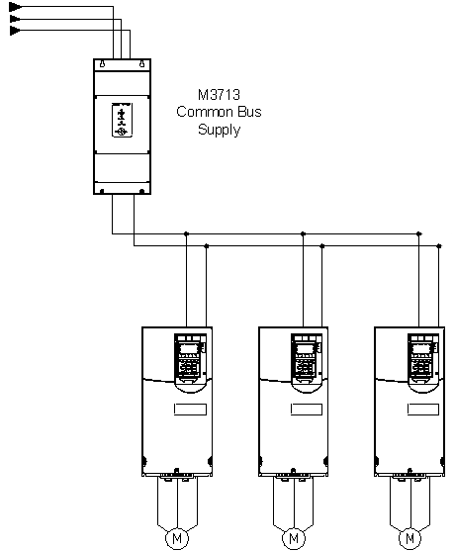
Common Bus Solutions
M3712 Single Phase
M3713 3-Phase
Common Bus Supply
Common Bus Drive Systems
230 - 600VAC
30 - 375A: Can be paralleled for more
12-18 Pulse Systems
Single phase
Add bulk capacitance to drive system
Power 3-Phase drives from single phase source
30
Notes:
30
An example of products in this category are the single and 3-phase power supplies used for component level drives, as a 6 pulse front end, and can be configured for 12 or 18 pulse inputs.

Slide 31
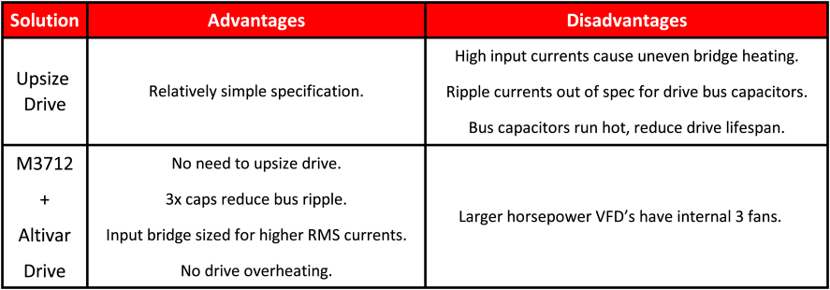
Common Bus Solutions

Slide 32
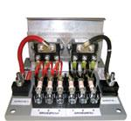
Common Bus Solutions
M3345CBM
M3345D
Common Bus Drive Systems
Common Bus Sharing Diodes (M3345CBM)
Isolation Diodes (M3345D)
Easily tie multiple drives onto one common DC bus
Notes:
32
For use with drive systems with multiple drives having multiple AC inputs.
Reduces circulating currents between drives, and allows for single braking solution

Slide 33
Maintenance Solutions
Notes:
Bonitron offers products in 6 main categories.

Slide 34
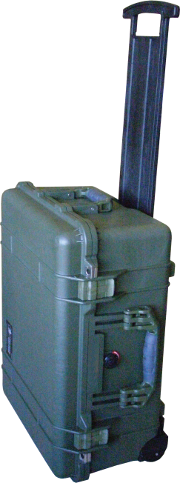
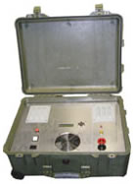
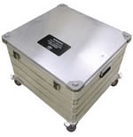
Maintenance Solutions
Capacitor Dischargers
Battery Testers
Rapidly tests M3528B Battery Modules
Capacitor Formers
Form capacitors
Benchtop power supply
Depletes energy stored in ultracapacitors
Capacitor Testers
Measure capacitance and ESR to determine when end of life is reached

Slide 35
Question and Answer
Introduction
What are Bonitron Solutions?
Why sell Bonitron Solutions?
Question and Answer?
Questions?
615-244-2825
info@bonitron.com

Slide 36
Cross References Online
bonitron.com/drive-schneider.html

Slide 37
Altivar 12
Example Table: More available at http://bonitron.com/drive-schneider.html

Slide 38
Contact us today
Charlie Adkins, P.E.
Tim Smith
Tommy Tyler
Vice President / Head of Engineering
CAdkins@Bonitron.com
Ext. 109
Sales Manager
TSmith@Bonitron.com
Ext.103
U.S. Distribution Manager
TTyler@Bonitron.com
Ext. 104
Derek Lovett
Inside Sales Support
DLovett@bonitron.com
Ext. 112
Quick and thorough support
Engineering & Sales
Contacts
Bonitron, Inc.
521 Fairground Court
Nashville, TN 37211
Tel: 615-244-2825
Fax: 615-244-2833
Web: www.bonitron.com

Slide 39
WWW.BONITRON.COM - 615-244-2825
BONITRON
Dedicated to Designing
and Manufacturing
Quality Industrial Electronics

