Slide 1

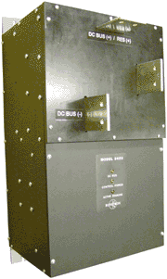

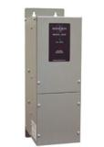

Bonitron, Inc.
Overvoltage Solutions
Allen Bradley® – Rockwell Automation
20110126

Slide 2


Introduction
Reputation
Successful in the braking chopper business for over two decades
Availability
Why Bonitron?
Dedicated sales team that works closely with engineering
Trained and experienced engineers
Certified solutions
Satisfied customers worldwide!
Stock to 2 weeks
www.bonitron.com
Notes:
Founded in 1962 as contract engineering company
Reputation for customer service and response

Slide 3
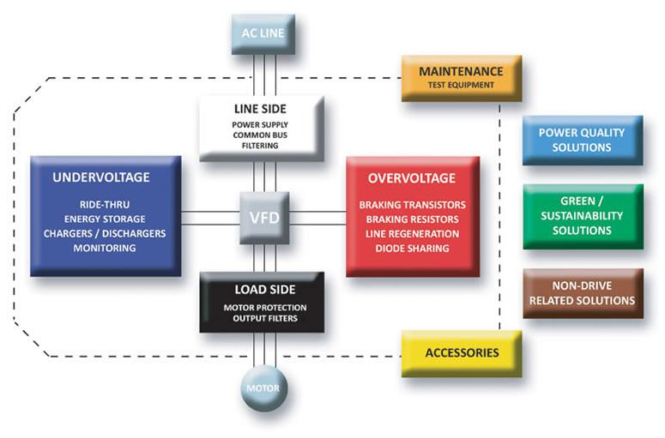
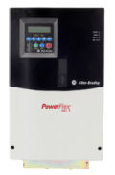
Bonitron Products
Notes:
Wide range of products for all VFD applications, industrial, commercial, critical process

Slide 4

PowerFlex® 750 Series
High Horsepower
Low Horsepower
Bonitron Choppers and Resistors can be used with any drive with DC bus connections
Frame sizes 8 and above do not have a 7th IGBT option.
Including 750 series drives with Side DC bus bar kit.
4
Notes:
2/9/2011
4
High power braking above 400 h.p. is not available as an integrated chopper.
For systems installed without choppers, Bonitron’s choppers can be easily added to an existing system.

Slide 5
Drive Topography

Slide 6

Chopper Selection
Braking Horsepower = Peak of drive output (usually 150% of rated H.P.)
Horsepower to Watts
Peak Current
Braking Resistance
Notes:
By and large, inertia calculations are done for drive selection, and braking solutions are a lower percentage of the system cost. Sizing the braking chopper to the drive is the most straightforward way to select a chopper.
The peak current determines the highest intermittent braking power available.

Slide 7
Transistor Duty Cycle
Duty Cycle
Overhauling deceleration times over 60 seconds are considered continuous.
Braking times over 120 seconds are considered continuous.
Transistor Duty Cycle
Continuous Rating
Overhauling
Braking
7
Notes:
7
Braking duty cycles determine the class of chopper, and also can have a large impact on the size of the resistor. This is the more important calculation when cost and footprint are big issues.
Rarely are duty cycles realistically above 50%.

Slide 8
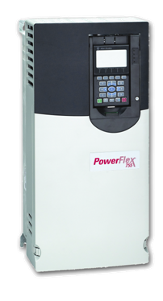
Bonitron Chopper Series
M3452
M3575T
M3675T
M3575R or M3775 Resistor
8
Notes:
Several footprints for DC Bus connection, depending on power rating and features

Slide 9
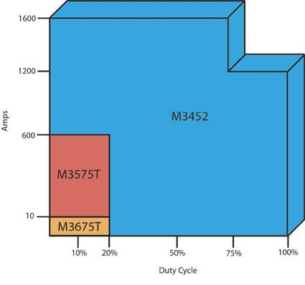
Bonitron Chopper Series
M3575T – Standard Duty Choppers
20% duty
10 – 600 A
230 – 460 VAC
M3675T Braking Transistor
Up to 10A
115 – 480VAC
M3452 – Heavy Duty Choppers
100, 50% duty
75 – 1600 A
230 – 690 VAC
Network Options
9

Slide 10
Bonitron Chopper Setpoints
Voltage Code | Nominal Line Voltage | Turn On | Turn Off
L | 230 VAC | 375 VDC | 360 VDC
H | 460 VAC | 750 VDC | 720 VDC
C | 575 VAC | 940 VDC | 880 VDC
Y | 690 VAC | 1090 VDC | 1060 VDC
10
Notes:
Trip points used to calculate the maximum current available, Divide the resistance into the “turn on” voltage to get the minimum resistance of the load bank.

Slide 11
Duty Cycle Example
Brake Module M3452-xxxx | Peak hp | Braking Amps (Peak) | Braking Amps (RMS)
H75B7, U75HB7 | 75 | 75 | 75
H150B7, U150HB7 | 150 | 150 | 150
H200K6, U200HK6 | 200 | 200 | 200
H300K6, U300HK6 | 300 | 300 | 300
H600K6, U600HK6 | 600 | 600 | 300
H800K9, U800HK9 | 800 | 800 | 400
H1200K10, U1200HK10 | 1200 | 1200 | 600
H1600M14, U1600HM14 | 1600 | 1600 | 1200
Choppers can be de-rated to obtain higher duty cycles
11
Notes:
Examples of how duty cycles are calculated. In this example, choppers up to 300 amps are 100%, 600-1200 are 50%, 1600 is 75%

Slide 12
Braking Transistors
“Chopper”
Full line of choppers. All Rockwell Product groups, 1336 through 755.
230-690 VAC
Up to 1600A per unit
Low and High Duty Cycle
Networking Options
Cross to 1336-W
Ethernet I/P and Profibus DP
“Transistor”
Notes:
12
Cross to 1336-W braking choppers, full range of voltages, power ratings and options, including networking.
R8 option - bus voltages
active duty cycle
heat sink temperature
Suitable for any common bus or separate chopper solution through full power range of 753 and 755 series

Slide 13
1336-W
1336 Series | Model Number | Peak HP | Peak Amp | Cont. Amp | Min. Ohm | Dimensions (H x W x D)
230 VAC Drives | "L" | 375VDC Setpoint
1336-WA018 | M3452-L75B7-A | 37.5 HP | 75 A | 75 A | 5.00 | 17.75 x 7.00 x 8.10"
1336-WA070 | M3452-L150B7-A | 75.0 HP | 150 A | 150 A | 2.50 | 17.75 x 7.00 x 8.10"
1336-WA115 | M3452-L300K6-A | 150.0 HP | 300 A | 300 A | 1.25 | 20.00 x 7.12 x 10.50"
460 VAC Drives | "H" | 750VDC Setpoint
1336-WB009 | M3452-H75B7-A | 75 HP | 75 A | 75 A | 10.00 | 17.75 x 7.00 x 8.10"
1336-WB035 | M3452-H75B7-A | 75 HP | 75 A | 75 A | 10.00 | 17.75 x 7.00 x 8.10"
1336-WB110 | M3452-H300K6-A | 300 HP | 300 A | 300 A | 2.50 | 20.00 x 7.12 x 10.50"
575-600 VAC Drives | "C" | 940VDC Setpoint
1336-WC009 | M3452-C75B7-A | 95 HP | 75 A | 75 A | 13.00 | 17.75 x 7.00 x 8.10"
1336-WC035 | M3452-C75B7-A | 95 HP | 75 A | 75 A | 13.00 | 17.75 x 7.00 x 8.10"
1336-WC085 | M3452-C300K6-A | 380 HP | 300 A | 300 A | 3.20 | 20.00 x 7.12 x 10.50"
13

Slide 14
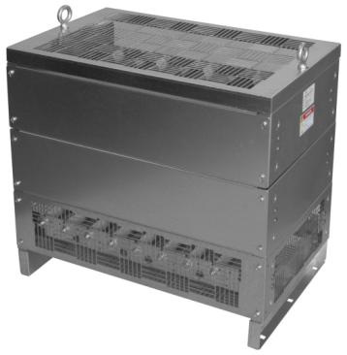
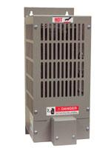
Bonitron Resistors
M3575R or M3775
14
Notes:
Resistors for all applications: Fractional ribwound < 50 h.p.
Grids to 150kw
Forced air to 2MW

Slide 15
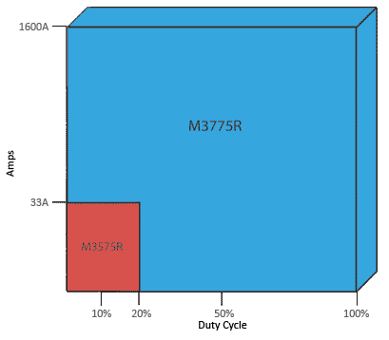
Bonitron Resistors
M3575R
Up to 33A
6 or 20% Duty
M3775R
Up to 1600+ Amps
10, 50, and 100% Duty
Convection or Fan Cooled
Custom Available
15

Slide 16
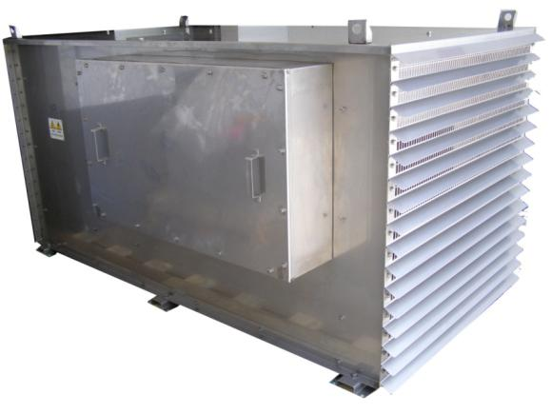
Custom Resistors
Fan Cooled Units
Vertical or Horizontal
NEMA-3R Options
Stainless Steel Options
306
316
Etc.
Multiple elements for multiple drives or choppers

Slide 17
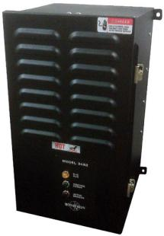
M3452 Complete Braking Kit
Cross to 1336-K
M3452 Combination Unit
400 - 1800 Watts continuous
6 – 43 HP
230 - 575VAC
17

Slide 18
1336-MOD-K
1336 Series | Model Number | Peak kW | Peak HP | Cont. Watts | Ohms | Dimensions (H x W x D)
230 VAC Drives | "L" | 375VDC Setpoint
1336-MOD-KA005 | M3452-L3B-R030 | 4.7 kW | 6.3 HP | 600 W | 30.0 | 18.25" x 9.50" x 8.50"
1336-MOD-KA010 | M3452-L9C-R015 | 9.4 kW | 12.6 HP | 1800 W | 15.0 | 18.25" x 11.50" x 10.50"
1336-MOD-KA050 | M3452-L75B7A* | 28.4 kW | 37.5 HP | 2800 W | 2.7 | 17.75" x 7.00" x 8.10"
 | M3775RK-L030A |  |  |  |  | 11.50" x 29.00" x 18.00"
460 VAC Drives | "H" | 750VDC Setpoint
1336-MOD-KB005 | M3452-H9C-R108 | 6.3 kW | 8.4 HP | 1800 W | 108.0 | 18.25" x 11.50" x 10.50"
1336-MOD-KB010 | M3452-H9C-R050 | 11.3 kW | 15.1 HP | 1800 W | 50.0 | 18.25" x 11.50" x 10.50"
1336-MOD-KB050 | M3575T-H75* | 56 kW | 75 HP | 5600 W | 10.0 | 12.75" x 4.00" x 8.70"
 | M3775RK-H075A |  |  |  |  | 11.50" x 29.00" x 18.00"
575-600 VAC Drives | "C" | 940VDC Setpoint
1336-MOD-KC005 | M3452-C9C-R108 | 6.3 kW | 8.4 HP | 600 W | 108.0 | 18.25" x 11.50" x 10.50"
1336-MOD-KC010 | M3452-C9C-R050 | 17.7 kW | 23.7 HP | 1800 W | 50.0 | 18.25" x 11.50" x 10.50"
1336-MOD-KB050 | M3452-C75B7A* | 56 kW | 75 HP | 5600 W | 15.6 | 17.75" x 7.00" x 8.10"
 | M3775RK-C075A |  |  |  |  | 11.50" x 29.00" x 18.00"
* Requires separate chopper and resistor
18
Notes:
2/9/2011
Functional equivalents for combination units
18

Slide 19
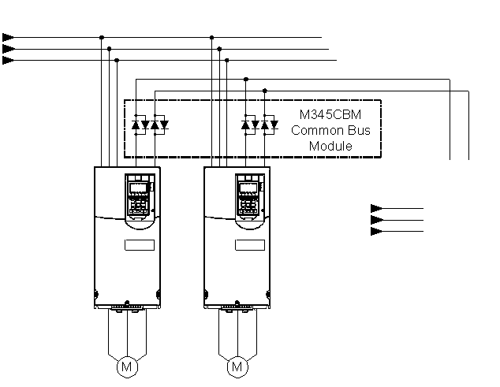
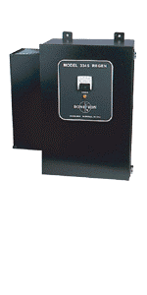
Line Regeneration
19
Notes:
2/9/2011
19
Alternative to resistive braking, energy efficient,

Slide 20
Line Regeneration
Lower energy cost than braking resistors
Typically saves money in applications with >50% Duty Cycle
Sizes
230 – 460VAC
10 to 120A
Parallel for higher hp applications
No additional filtering required.
Great return on investment
Notes:
20
Functional equivalent to 1336R, here’s a few reasons why you would use a regen over a chopper
For 1336R used as bus supplies, we have a separate bridge.

Slide 21
Bonitron 1336R Solutions
1336R Series | Model Number | Cont. HP | Peak Amp | Cont. Amp | Dimensions (H x W x D)
380-415 VAC
1336R-VB048 | M3345-3AWMFM | 40 | 60 | 55 | 24.00 x 10.00 x 10.50"
1336R-VB078 | (2X) M3345-3AWMFM | 80 | 120 | 110 | (2X) 24.00 x 10.00 x 10.50"
1336R-VB180 | (3X) M3345-35WMFM | 150 | 270 | 165 | (3X) 24.00 x 10.00 x 10.50"
460-480 VAC Drives
1336R-VB048 | M3345-4AWMFM | 50 | 60 | 55 | 24.00 x 10.00 x 10.50"
1336R-VB078 | (2X) M3345-4AWMFM | 100 | 120 | 110 | (2X) 24.00 x 10.00 x 10.50"
1336R-VB180 | (3X) M3345-45WMFM | 210 | 270 | 165 | (3X) 24.00 x 10.00 x 10.50"

Slide 22
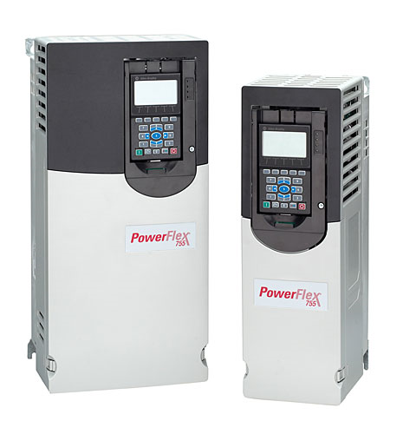
High Power Solutions
All current drive models
753 and 755 Drive Systems
Braking Choppers
Regens
Bus Power Supplies
Ride-Thru
Common Bus solutions
22
Notes:
2/9/2011
22

Slide 23
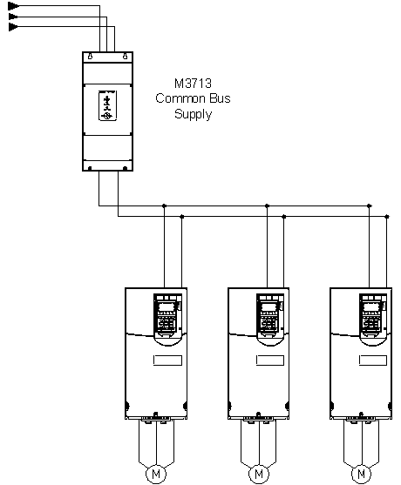
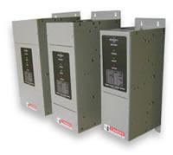
Input Bridges
M3713
Common Bus Supply
23
Notes:
23
Used for component level drives, 6 pulse front end, can be configured for 12 or 18 pulse inputs
Make sure at least one drive is precharged and on line before enabling chopper module!

Slide 24
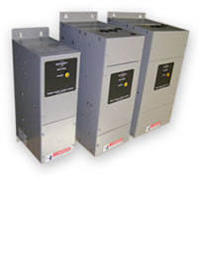
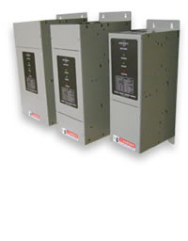
Input Bridges
M3713SC
With Pre-charge
M3713DM
Without Pre-charge
Common Bus Drive Systems
230-600VAC
30-375A
Can be paralleled
12-18 Pulse Systems
Single phase versions add bulk capacitance to drive system.
Notes:
24

Slide 25
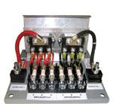
Common Bus Module
M3345CBM
Notes:
25
For use with drive systems with multiple drives having multiple AC inputs.
Reduces circulating currents between drives, and allows for single braking solution
Make sure at least one drive is precharged and on line before enabling chopper module!

Slide 26
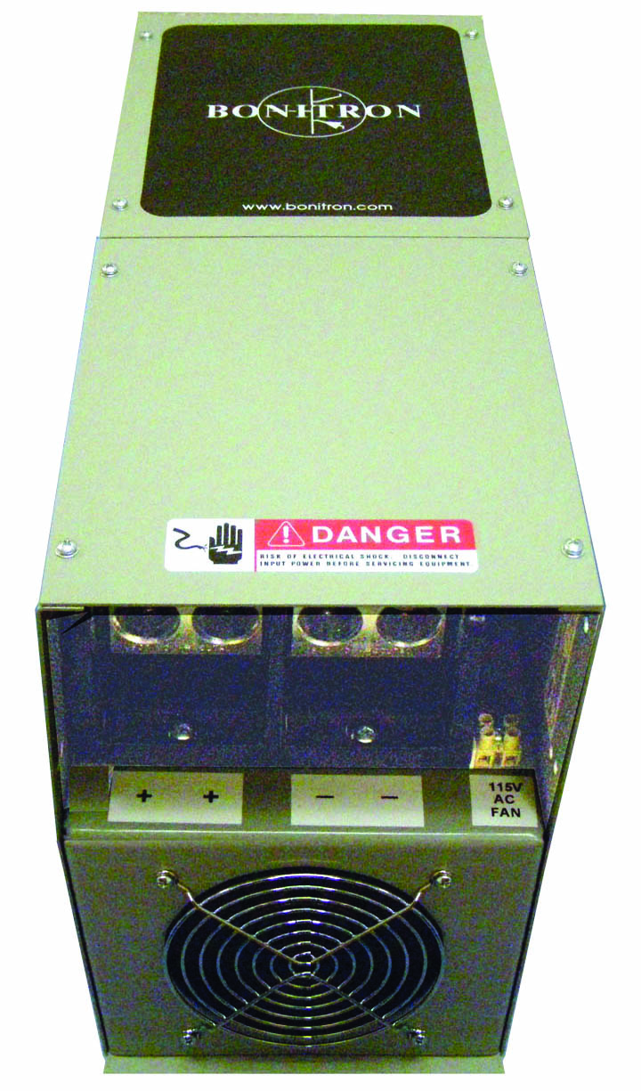
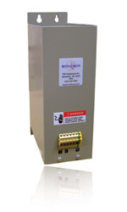
Common Bus
M3612EC
Bulk capacitance
M3612RC
DC Bus snubber
Notes:
Bulk capacitance can be used for low level ridethrough or increased bus filter capacitance
DC bus snubbers recommended for high frequency filtering of diode switching for 6 pulse front ends

Slide 27
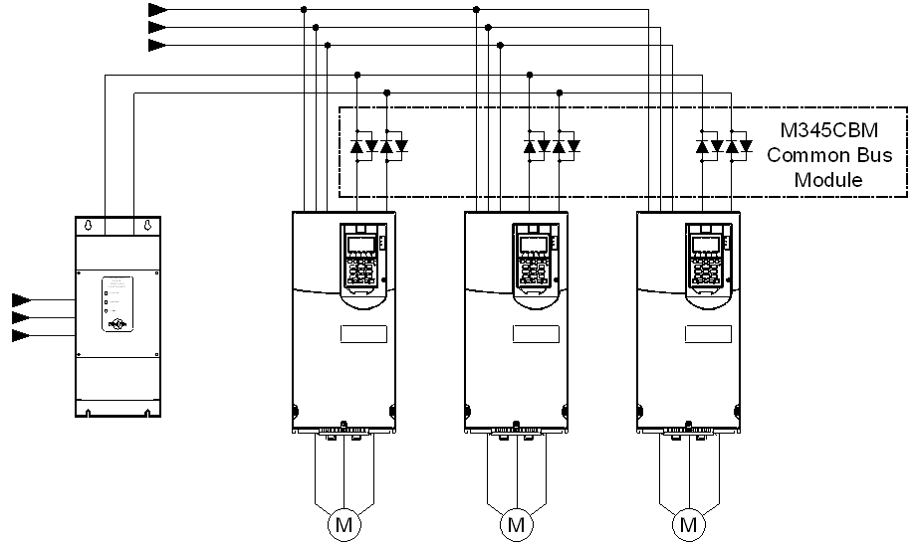
Ride-Thru
3534 or 3460
Ride-Thru
27
Notes:
DC ridethrough allows for system backup for power outages or severe AC input sags

Slide 28
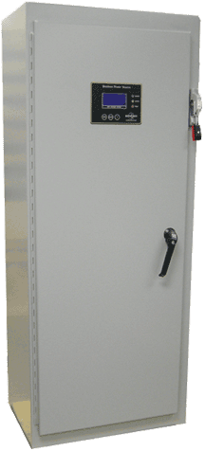
Ride-Thru Advantages
Simple retrofit or initial installation
Parallel configuration for increased reliability
Increased uptime
Maintain speed and torque during an AC line sag or outage
DC backup for VFD
28
Notes:
28
Critical applications ride through power quality issues, sags or outages
Local and parallel installation means protection from faults on grid all the way to the input of the drive, not just faults external to the plant.

Slide 29
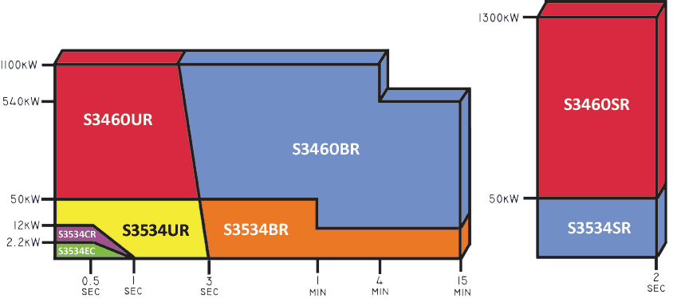
DC Bus Ride-Thru
Maintain DC Bus Voltage during an AC line sag.
29

Slide 30
www.bonitron.com
30
Notes:
30
All the possible combinations of Bonitron products with drive systems.

Slide 31
www.bonitron.com
31
Notes:
31

Slide 32

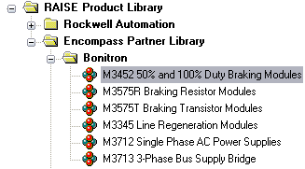
Support Channels
ProposalWorks
Enhanced website
Cross references
Web training schedules
http://www.bonitron.com/drive-ab.html
Notes:
Bonitron support channels listed.
Adding and enhancing listings in proposalworks
Making website easier to navigate
Generating cross references that have specific drive part numbers and equivalent or applicable Bonitron numbers, most current version always on the website
Can schedule web training for individuals or groups, can arrange presentations in person for groups or application assistance

Slide 33

www.bonitron.com
Notes:
Click Drive MFGs and then AB | Rockwell to find AB Rockwell page on bonitron.com

Slide 34

www.bonitron.com
Click the Encompass Logo to see Bonitron on RAISE online

Slide 35
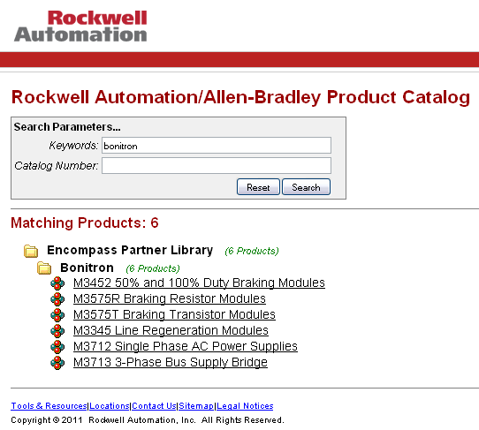
Bonitron on RAISE

Slide 36
Engineering & Sales
Points of Contact
Charlie Adkins, P.E.
Tim Smith
Tommy Tyler
Vice President
CAdkins@Bonitron.com
Ext. 109
Sales Manager
TSmith@Bonitron.com
Ext.103
U.S. Distribution Manager
TTyler@Bonitron.com
Ext. 104
Derek Lovett
Inside Sales
DLovett@bonitron.com
Ext. 112
Bonitron, Inc.
521 Fairground Court
Nashville, TN 37211
Tel: 615-244-2825
Fax: 615-244-2833
Web: www.bonitron.com
36

Slide 37
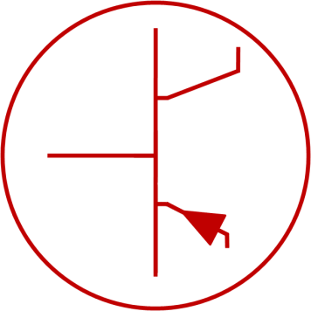
BONITRON
Dedicated to Designing
and Manufacturing
Quality Industrial Electronics
37
Notes:
37

Slide 38
M3575T Standard Duty
Model Number | Drive Voltage | I_{pk} | I_{rms} | UL Rating | Duty Cycle | Max Braking | Min Load | Chassis Size
M3575T-L15 | 230VAC | 15A | 3.87A | 20% | 20% | 8hp | 25Ω | M3
M3575T-L30 |  | 30A | 7.75A | 20% | 20% | 15hp | 12.5Ω | M3
M3575T-L60 |  | 60A | 15.5A | 20% | 60% | 30hp | 6.25Ω | M4
M3575T-H15 | 460VAC | 15A | 3.87A | 20% | 20% | 15hp | 50Ω | M3
M3575T-H30 |  | 30A | 7.75A | 20% | 20% | 30hp | 25Ω | M3
M3575T-H75 |  | 75A | 19.36A | 20% | 60% | 75hp | 10Ω | M4
M3575T-H125 |  | 125A | 32.27A | 20% | 20% | 125hp | 6Ω | B5
M3575T-H150 |  | 150A | 38.73A | 20% | 20% | 150hp | 5Ω | B5
M3575T-H200 |  | 200A | 51.64A | 20% | 20% | 200hp | 3.75Ω | B7
M3575T-H300 |  | 300A | 77.46A | 20% | 20% | 300hp | 2.5Ω | B7
M3575T-H600 |  | 600A | 154.92A | 20% | 20% | 600hp | 1.25Ω | B7
38

Slide 39
M3452 Heavy Duty Chopper
Model Number | DC Threshold Voltage | DC Current | Duty Cycle | Fuse | Minimum Load Resistance
M3452-H200K6, U200HK6 | 750V DC | 200 A | 100% | FWP-200 | 3.8Ω
M3452-H300K6, U300HK6 | 750V DC | 300 A | 100% | FWP-300 | 2.5Ω
M3452-H600K6, U600HK6 | 750V DC | 600 A | 50% | A70QS600 | 1.25Ω
M3452-H800K9, U800HK9 | 750V DC | 800 A | 50% | A70QS800 | 0.93Ω
M3452-H1200K10, U1200HK10 | 750V DC | 1200 A | 50% | A70QS800 | 0.63Ω
M3452-H1600M14, U1600HM14 | 750V DC | 1600 A | 75% | N/A | 0.47Ω
M3452-C200K6, U200CK6 | 940V DC | 200 A | 100% | A100P200 | 4.7Ω
M3452-C300K6, U300CK6 | 940V DC | 300 A | 100% | A100P300 | 3.2Ω
M3452-C600K6, U600CK6 | 940V DC | 600 A | 50% | A70QS600 | 1.6Ω
M3452-C800K9, U800CK9 | 940V DC | 800 A | 50% | A70QS800 | 1.2Ω
M3452-C1200K10, U1200CK10 | 940V DC | 1200 A | 50% | A70QS800 | 0.78Ω
M3452-C1600M14, U1600CM14 | 940V DC | 1600 A | 75% | N/A | 0.58Ω
M3452-U200YK6 | 1090V DC | 200 A | 100% | A100P200 | 5.5Ω
M3452-U300YK6 | 1090V DC | 300 A | 100% | A100P300 | 3.6Ω
M3452-U600YK6 | 1090V DC | 600 A | 50% | A70QS600 | 1.8Ω
M3452-U800YK9 | 1090V DC | 800 A | 50% | A70QS800 | 1.4Ω
M3452-U1200YK10 | 1090V DC | 1200 A | 50% | A70QS800 | 0.91Ω
M3452-U1600YM14 | 1090V DC | 1600 A | 75% | N/A | 0.68Ω
39

Slide 40
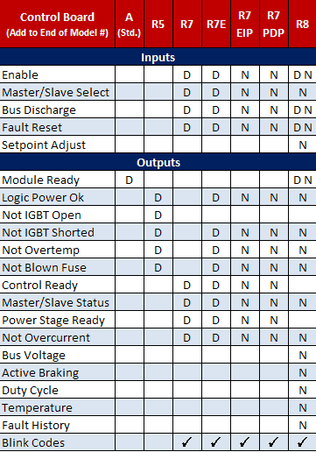
M3452 Control Options
40

Slide 41
M3452 Complete Braking Kit
Part Number | Voltage | Peak kW | Peak hp | Cont. Watts | Chx | Ohms | Braking Duty Cycle | Cont.Duty Cycle
M3452-L2B-R030 | 230 | 4.8 | 6.4 | 400 | B | 30.0 | 20% | 10%
M3452-L3B-R020 | 230 | 7.1 | 9.6 | 600 | B | 20.0 | 20% | 10%
M3452-L3B-R030 | 230 | 4.7 | 6.3 | 600 | B | 30.0 | 20% | 10%
M3452-L6B-R010 | 230 | 14.3 | 19.1 | 1200 | B | 10.0 | 20% | 10%
M3452-L8C-R004 | 230 | 32.0 | 43.0 | 1600 | C | 4.4 | 10% | 5%
M3452-L9C-R007 | 230 | 20.3 | 27.1 | 1800 | C | 6.7 | 20% | 10%
M3452-L9C-R015 | 230 | 9.4 | 12.6 | 1800 | C | 15.0 | 40% | 20%
M3452-H2B-R120 | 460 | 4.7 | 6.3 | 400 | B | 120.0 | 20% | 10%
M3452-H3B-R075 | 460 | 6.8 | 9.0 | 600 | B | 75.0 | 20% | 10%
M3452-H6B-R038 | 460 | 13.5 | 18.1 | 1200 | B | 37.5 | 20% | 10%
M3452-H8C-R018 | 460 | 32.0 | 43.0 | 1600 | C | 17.5 | 10% | 5%
M3452-H9C-R025 | 460 | 20.3 | 27.1 | 1800 | C | 25.0 | 20% | 10%
M3452-H9C-R050 | 460 | 11.3 | 15.1 | 1800 | C | 50.0 | 30% | 15%
M3452-H9C-R108 | 460 | 6.3 | 8.4 | 1800 | C | 108.0 | 60% | 30%
M3452-C2B-R120 | 575 | 5.9 | 7.9 | 400 | B | 120.0 | 10% | 5%
M3452-C3B-R075 | 575 | 8.4 | 11.3 | 600 | B | 105.0 | 15% | 8%
M3452-C6B-R053 | 575 | 14.1 | 18.9 | 1200 | B | 52.5 | 20% | 10%
M3452-C9C-R035 | 575 | 21.6 | 29.0 | 1800 | C | 35.0 | 20% | 10%
M3452-C9C-R050 | 575 | 17.7 | 23.7 | 1800 | C | 50.0 | 20% | 10%
M3452-C9C-R108 | 575 | 6.3 | 8.4 | 600 | C | 108.0 | 60% | 30%
41

Slide 42
1336-MOD-K
1336 Series | Model Number | Peak kW | Peak HP | Cont. Watts | Ohms | Dimensions (H x W x D)
230 VAC Drives | "L" | 375VDC Setpoint
1336-MOD-KA005 | M3452-L3B-R030 | 4.7 kW | 6.3 HP | 600 W | 30.0 | 18.25" x 9.50" x 8.50"
1336-MOD-KA010 | M3452-L9C-R015 | 9.4 kW | 12.6 HP | 1800 W | 15.0 | 18.25" x 11.50" x 10.50"
1336-MOD-KA050 | M3452-L75B7A* | 28.4 kW | 37.5 HP | 2800 W | 2.7 | 17.75" x 7.00" x 8.10"
 | M3775RK-L030A |  |  |  |  | 11.50" x 29.00" x 18.00"
460 VAC Drives | "H" | 750VDC Setpoint
1336-MOD-KB005 | M3452-H9C-R108 | 6.3 kW | 8.4 HP | 1800 W | 108.0 | 18.25" x 11.50" x 10.50"
1336-MOD-KB010 | M3452-H9C-R050 | 11.3 kW | 15.1 HP | 1800 W | 50.0 | 18.25" x 11.50" x 10.50"
1336-MOD-KB050 | M3575T-H75* | 56 kW | 75 HP | 5600 W | 10.0 | 12.75" x 4.00" x 8.70"
 | M3775RK-H075A |  |  |  |  | 11.50" x 29.00" x 18.00"
575-600 VAC Drives | "C" | 940VDC Setpoint
1336-MOD-KC005 | M3452-C9C-R108 | 6.3 kW | 8.4 HP | 600 W | 108.0 | 18.25" x 11.50" x 10.50"
1336-MOD-KC010 | M3452-C9C-R050 | 17.7 kW | 23.7 HP | 1800 W | 50.0 | 18.25" x 11.50" x 10.50"
1336-MOD-KB050 | M3452-C75B7A* | 56 kW | 75 HP | 5600 W | 15.6 | 17.75" x 7.00" x 8.10"
 | M3775RK-C075A |  |  |  |  | 11.50" x 29.00" x 18.00"
* Requires separate chopper and resistor
42

Slide 43
1336-W
1336 Series | Model Number | Peak HP | Peak Amp | Cont. Amp | Min. Ohm | Dimensions (H x W x D)
230 VAC Drives | "L" | 375VDC Setpoint
1336-WA018 | M3452-L75B7-A | 37.5 HP | 75 A | 75 A | 5.00 | 17.75 x 7.00 x 8.10"
1336-WA070 | M3452-L150B7-A | 75.0 HP | 150 A | 150 A | 2.50 | 17.75 x 7.00 x 8.10"
1336-WA115 | M3452-L300K6-A | 150.0 HP | 300 A | 300 A | 1.25 | 20.00 x 7.12 x 10.50"
460 VAC Drives | "H" | 750VDC Setpoint
1336-WB009 | M3452-H75B7-A | 75 HP | 75 A | 75 A | 10.00 | 17.75 x 7.00 x 8.10"
1336-WB035 | M3452-H75B7-A | 75 HP | 75 A | 75 A | 10.00 | 17.75 x 7.00 x 8.10"
1336-WB110 | M3452-H300K6-A | 300 HP | 300 A | 300 A | 2.50 | 20.00 x 7.12 x 10.50"
575-600 VAC Drives | "C" | 940VDC Setpoint
1336-WC009 | M3452-C75B7-A | 95 HP | 75 A | 75 A | 13.00 | 17.75 x 7.00 x 8.10"
1336-WC035 | M3452-C75B7-A | 95 HP | 75 A | 75 A | 13.00 | 17.75 x 7.00 x 8.10"
1336-WC085 | M3452-C300K6-A | 380 HP | 300 A | 300 A | 3.20 | 20.00 x 7.12 x 10.50"
43

Slide 44
1336R
1336R Series | Model Number | Cont. HP | Peak Amp | Cont. Amp | Dimensions (H x W x D)
380-415 VAC
1336R-VB048 | M3345-3AWMFM | 40 | 60 | 55 | 24.00 x 10.00 x 10.50"
1336R-VB078 | (2X) M3345-3AWMFM | 80 | 120 | 110 | (2X) 24.00 x 10.00 x 10.50"
1336R-VB180 | (3X) M3345-35WMFM | 150 | 270 | 165 | (3X) 24.00 x 10.00 x 10.50"
460-480 VAC Drives
1336R-VB048 | M3345-4AWMFM | 50 | 60 | 55 | 24.00 x 10.00 x 10.50"
1336R-VB078 | (2X) M3345-4AWMFM | 100 | 120 | 110 | (2X) 24.00 x 10.00 x 10.50"
1336R-VB180 | (3X) M3345-45WMFM | 210 | 270 | 165 | (3X) 24.00 x 10.00 x 10.50"

Slide 45
PowerFlex 755…
PowerFlex 755 Series
RA Model Number | Normal Duty kW | Normal Duty HP | Internal Transistor | Resistor w/ Internal Transistor | 10% Overhauling | 20% Braking |  | 50% Overhauling |  | 100% Overhauling
 |  |  |  |  | Transistor | Resistor | Transistor | Resistor | Transistor | Resistor
480VAC Drives
20Gxxxx2P1 | 0.7457 | 1 | YES | M3575R-H16BF | M3675T-H10 | M3575R-H2MF | M3675T-H10 | M3775RK-H1.50B | M3675T-H10 | M3775RK-H1.50C
20Gxxxx3P4 | 1.4914 | 2 | YES |  |  | M3575R-H3MF |  | M3775RK-H3.00B | M3575T-H15 | M3775RK-H3.00C
20Gxxxx5P0 | 2.2371 | 3 | YES |  |  | M3575R-H5BF | M3575T-H15 | M3775RK-H5.00B | M3575T-H30 | M3775RK-H5.00C
20Gxxxx8P0 | 3.7285 | 5 | YES |  |  | M3575R-H8BF | M3575T-H30 | M3775RK-H7.50B | M3575T-H75 | M3775RK-H7.50C
20Gxxxx011 | 5.59275 | 7.5 | YES |  | M3575T-H15 | M3575R-H11BF |  | M3775RK-H015B |  | M3775RK-H015C
20Gxxxx014 | 7.457 | 10 | YES |  |  | M3575R-H16BF | M3575T-H75
20Gxxxx022 | 11.1855 | 15 | YES | M3575R-H27BF | M3575T-H30 | M3575R-H24BF |  | M3775RK-H025B | M3575T-H125 | M3775RK-H025C
20Gxxxx027 | 14.914 | 20 | YES | M3575R-H16BF |  | M3575R-H33BF |  | M3775RK-H030B | M3452-H75B7A | M3775RK-H030C
20Gxxxx034 | 18.6425 | 25 | YES |  | M3575T-H75 | M3775RK-H040A | M3575T-H125 | M3775RK-H040B |  | M3775RK-H040C
20Gxxxx040 | 22.371 | 30 | YES | M3575R-H33BF |  | M3775RK-H050A |  | M3775RK-H050B |  | M3775RK-H050C
20Gxxxx052 | 29.828 | 40 | YES | M3775RK-H040A |  | M3775RK-H060A | M3452-H75B7A | M3775RK-H060B |  | M3775RK-H060C
20Gxxxx065 | 37.285 | 50 | YES | M3775RK-H040A** |  | M3775RK-H075A |  | M3775RK-H075B |  | M3775RK-H075C
20Gxxxx077 | 44.742 | 60 | YES | M3775RK-H075A** | M3575T-H125 | M3775RK-H100A | M3452-H150B7A | M3775RK-H100B | M3452-H150B7A | M3775RK-H100C
20Gxxxx096 | 55.9275 | 75 | YES* |  |  | M3775RK-H125A |  | M3775RK-H125B |  | M3775RK-H125C
20Gxxxx125 | 74.57 | 100 | OPTION | M3775RK-H200A | M3575T-H150 | M3775RK-H150A |  | M3775RK-H150B |  | M3775RK-H150C
20Gxxxx156 | 93.2125 | 125 | OPTION |  | M3575T-H200 | M3775RK-H200A | M3452-H200K6A | M3775RK-H200B | M3452-H200K6A | M3775RK-H200C
20Gxxxx186 | 111.855 | 150 | OPTION |  | M3575T-H300 | M3775RK-H250A | M3452-H300K6A | M3775RK-H250B | M3452-H300K6A | M3775RL-H300C
20Gxxxx248 | 149.14 | 200 | OPTION | M3775RK-H200A** |  | M3775RK-H300A |  | M3775RL-H300B
20Gxxxx302 | 186.425 | 250 | OPTION | M3775RK-H300A | M3575T-H600 | M3775RK-H400A | M3452-H600K6A | M3775RL-H600B | M3452-H800K9A | M3775RL-H600C
20Gxxxx361 | 223.71 | 300 | OPTION |  |  | M3775RK-H500A |  |  | M3452-H1200K10R7
20Gxxxx415 | 260.995 | 350 | OPTION | M3775RK-H400A |  | M3775RK-H600A
20Gxxxx430 | 260.995 | 350 | NO | N/A
20Gxxxx485 | 298.28 | 400 | NO
20Gxxxx545 | 335.565 | 450 | NO |  | M3452-H800K9A | M3775RL-H800A | M3452-H800K9A | M3775RL-H800B | M3452-H1600M14R7 | M3775RL-H800C
20Gxxxx617 | 372.85 | 500 | NO
20Gxxxx710 | 447.42 | 600 | NO |  | M3452-H1200K10R7 | M3775RL-H1200A | M3452-H1200K10R7 | M3775RL-H1200B |  | M3775RL-H1200C
20Gxxxx740 | 484.705 | 650 | NO

Slide 46
…PowerFlex 755
PowerFlex 755 Series
RA Model Number | Normal Duty kW | Normal Duty HP | Internal Transistor | Resistor w/ Internal Transistor | 10% Overhauling | 20% Braking |  | 50% Overhauling |  | 100% Overhauling
 |  |  |  |  | Transistor | Resistor | Transistor | Resistor | Transistor | Resistor
480VAC Drives with Cabinet Option
21Gxxxx2P1 | 0.7 | 1 | YES | M3575R-H16BF | M3675T-H10 | M3575R-H2MF | M3675T-H10 | M3775RK-H1.50B | M3675T-H10 | M3775RK-H1.50C
21Gxxxx3P4 | 1.5 | 2 | YES |  |  | M3575R-H3MF | M3675T-H10 | M3775RK-H3.00B | M3575T-H15 | M3775RK-H3.00C
21Gxxxx5P0 | 2.2 | 3 | YES |  |  | M3575R-H5BF | M3575T-H15 | M3775RK-H5.00B | M3575T-H30 | M3775RK-H5.00C
21Gxxxx8P0 | 3.7 | 5 | YES |  |  | M3575R-H8BF | M3575T-H30 | M3775RK-H7.50B | M3575T-H75 | M3775RK-H7.50C
21Gxxxx011 | 5.6 | 7.5 | YES |  | M3575T-H15 | M3575R-H11BF |  | M3775RK-H015B |  | M3775RK-H015C
21Gxxxx014 | 7.5 | 10 | YES |  |  | M3575R-H16BF | M3575T-H75
21Gxxxx022 | 11.2 | 15 | YES | M3575R-H27BF | M3575T-H30 | M3575R-H24BF |  | M3775RK-H025B | M3575T-H125 | M3775RK-H025C
21Gxxxx027 | 14.9 | 20 | YES | M3575R-H16BF |  | M3575R-H33BF |  | M3775RK-H030B |  | M3775RK-H030C
21Gxxxx034 | 18.6 | 25 | YES |  | M3575T-H75 | M3775RK-H040A | M3575T-H125 | M3775RK-H040B | M3452-H75B7A | M3775RK-H040C
21Gxxxx040 | 22.4 | 30 | YES | M3575R-H33BF |  | M3775RK-H050A |  | M3775RK-H050B |  | M3775RK-H050C
21Gxxxx052 | 29.8 | 40 | YES | M3775RK-H040A |  | M3775RK-H060A | M3452-H75B7A | M3775RK-H060B |  | M3775RK-H060C
21Gxxxx065 | 37.3 | 50 | YES | M3775RK-H040A** |  | M3775RK-H075A |  | M3775RK-H075B |  | M3775RK-H075C
21Gxxxx077 | 44.7 | 60 | YES | M3775RK-H075A** | M3575T-H125 | M3775RK-H100A | M3452-H150B7A | M3775RK-H100B | M3452-H150B7A | M3775RK-H100C
21Gxxxx096 | 55.9 | 75 | YES* |  |  | M3775RK-H125A |  | M3775RK-H125B |  | M3775RK-H125C
21Gxxxx125 | 74.6 | 100 | OPTION | M3775RK-H200A | M3575T-H150 | M3775RK-H150A |  | M3775RK-H150B |  | M3775RL-H150C
21Gxxxx156 | 93.2 | 125 | OPTION |  | M3575T-H200 | M3775RK-H200A | M3452-H200K6A | M3775RK-H200B | M3452-H200K6A | M3775RL-H200C
21Gxxxx186 | 111.9 | 150 | OPTION |  | M3575T-H300 | M3775RK-H250A | M3452-H300K6A | M3775RL-H300B | M3452-H300K6A | M3775RL-H300C
21Gxxxx248 | 149.1 | 200 | OPTION | M3775RK-H200A** |  | M3775RK-H300A
21Gxxxx302 | 186.4 | 250 | OPTION | M3775RK-H300A | M3575T-H600 | M3775RK-H400A | M3452-H600K6A | M3775RL-H600B | M3452-H800K9A | M3775RL-H600C
21Gxxxx361 | 223.7 | 300 | OPTION |  |  | M3775RK-H500A |  |  | M3452-H1200K10R7
21Gxxxx415 | 261.0 | 350 | OPTION | M3775RK-H400A |  | M3775RK-H600A
21Gxxxx430 | 261.0 | 350 | NO | N/A
21Gxxxx485 | 298.3 | 400 | NO
21Gxxxx545 | 335.6 | 450 | NO |  | M3452-H800K9A | M3775RL-H800A | M3452-H800K9A | M3775RL-H800B | M3452-H1600M14R7 | M3775RL-H800C
21Gxxxx617 | 372.9 | 500 | NO
21Gxxxx710 | 447.4 | 600 | NO |  | M3452-H1200K10R7 | M3775RL-H1200A | M3452-H1200K10R7 | M3775RL-H1200B |  | M3775RL-H1200C
21Gxxxx740 | 484.7 | 650 | NO

Slide 47
PowerFlex 753
PowerFlex 753 Series
RA Model Number | Normal Duty kW | Normal Duty HP | Internal Transistor | Resistor w/ Internal Transistor | 10% Overhauling | 20% Braking |  | 50% Overhauling |  | 100% Overhauling
 |  |  |  |  | Transistor | Resistor | Transistor | Resistor | Transistor | Resistor
480VAC Drives
20Fxxxx2P1 | 0.7 | 1 | YES | M3575R-H16BF | M3675T-H10 | M3575R-H2MF | M3675T-H10 | M3775RK-H1.50B | M3675T-H10 | M3775RK-H1.50C
20Fxxxx3P4 | 1.5 | 2 | YES |  |  | M3575R-H3MF |  | M3775RK-H3.00B | M3575T-H15 | M3775RK-H3.00C
20Fxxxx5P0 | 2.2 | 3 | YES |  |  | M3575R-H5BF | M3575T-H15 | M3775RK-H5.00B | M3575T-H30 | M3775RK-H5.00C
20Fxxxx8P0 | 3.7 | 5 | YES |  |  | M3575R-H8BF | M3575T-H30 | M3775RK-H7.50B | M3575T-H75 | M3775RK-H7.50C
20Fxxxx011 | 5.6 | 7.5 | YES |  | M3575T-H15 | M3575R-H11BF |  | M3775RK-H015B |  | M3775RK-H015C
20Fxxxx014 | 7.5 | 10 | YES |  |  | M3575R-H16BF | M3575T-H75
20Fxxxx022 | 11.2 | 15 | YES | M3575R-H27BF | M3575T-H30 | M3575R-H24BF |  | M3775RK-H025B | M3575T-H125 | M3775RK-H025C
20Fxxxx027 | 14.9 | 20 | YES | M3575R-H16BF |  | M3575R-H33BF |  | M3775RK-H030B | M3452-H75B7A | M3775RK-H030C
20Fxxxx034 | 18.6 | 25 | YES |  | M3575T-H75 | M3775RK-H040A | M3575T-H125 | M3775RK-H040B |  | M3775RK-H040C
20Fxxxx040 | 22.4 | 30 | YES | M3575R-H33BF |  | M3775RK-H050A |  | M3775RK-H050B |  | M3775RK-H050C
20Fxxxx052 | 29.8 | 40 | YES | M3775RK-H040A |  | M3775RK-H060A | M3452-H75B7A | M3775RK-H060B |  | M3775RK-H060C
20Fxxxx065 | 37.3 | 50 | YES | M3775RK-H040A** |  | M3775RK-H075A |  | M3775RK-H075B |  | M3775RK-H075C
20Fxxxx077 | 44.7 | 60 | YES | M3775RK-H075A** | M3575T-H125 | M3775RK-H100A | M3452-H150B7A | M3775RK-H100B | M3452-H150B7A | M3775RK-H100C
20Fxxxx096 | 55.9 | 75 | YES* |  |  | M3775RK-H125A |  | M3775RK-H125B |  | M3775RK-H125C
20Fxxxx125 | 74.6 | 100 | OPTION | M3775RK-H200A | M3575T-H150 | M3775RK-H150A |  | M3775RK-H150B |  | M3775RL-H150C
20Fxxxx156 | 93.2 | 125 | OPTION |  | M3575T-H200 | M3775RK-H200A | M3452-H200K6A | M3775RK-H200B | M3452-H200K6A | M3775RL-H200C
20Fxxxx186 | 111.9 | 150 | OPTION |  | M3575T-H300 | M3775RK-H250A | M3452-H300K6A | M3775RK-H250B | M3452-H300K6A | M3775RL-H300C
20Fxxxx248 | 149.1 | 200 | OPTION | M3775RK-H200A** |  | M3775RK-H300A |  | M3775RL-H300B
20Fxxxx302 | 186.4 | 250 | OPTION | M3775RK-H300A | M3575T-H600 | M3775RK-H400A | M3452-H600K6A | M3775RL-H600B | M3452-H800K9A | M3775RL-H600C
20Fxxxx361 | 223.7 | 300 | OPTION |  |  | M3775RK-H500A |  |  | M3452-H1200K10R7
20Fxxxx415 | 261.0 | 350 | OPTION | M3775RK-H400A |  | M3775RK-H600A

Slide 48
PowerFlex 700S | 240VAC
PowerFlex 700S Series
RA Model Number | Normal Duty kW | Normal Duty HP | Heavy Duty HP | Internal Transistor | Resistor w/ Internal Transistor | 10% Overhauling | 20% Braking |  | 50% Overhauling |  | 100% Overhauling
 |  |  |  |  |  | Transistor | Resistor | Transistor | Resistor | Transistor | Resistor
240VAC Drives
20DB4P2 | 0.75 | 1 | 0.75 | YES | M3575R-L5BF | M3675T-L10 | M3575R-L2MF | M3675T-L10 | M3775RK-L1.50B | M3575T-L15 | M3775RK-L1.50C
20DB6P8 | 1.5 | 2 | 1.5 | YES |  |  | M3575R-L3MF | M3575T-L15 | M3775RK-L3.00B | M3575T-L30 | M3775RK-L3.00C
20DB9P6 | 2.2 | 3 | 2 | YES |  |  | M3575R-L5BF | M3575T-L30 | M3775RK-L5.00B | M3575T-L60 | M3775RK-L5.00C
20DB015 | 3.7 | 5 | 3 | YES | M3575R-L6MF | M3575T-L15 | M3575R-L8BF | M3575T-L60 | M3775RK-L010B | M3452-L75B7A | M3775RK-L010C
20DB022 | 5.6 | 7.5 | 5 | YES | M3575R-L8BF | M3575T-L30 | M3575R-L16BF |  | M3775RK-L015B |  | M3775RK-L015C
20DB028 | 7.5 | 10 | 7.5 | YES | M3575R-L9MF |  |  | M3452-L75B7A
20DB042 | 11.2 | 15 | 10 | YES | M3575R-L16BF | M3575T-L60 | M3575R-L24BF |  | M3775RK-L025B |  | M3775RK-L025C
20DB052 | 14.9 | 20 | 15 | YES | M3775RK-L020A |  | M3775RK-L030A |  | M3775RK-L030B |  | M3775RK-L030C
20DB070 | 18.6 | 25 | 20 | OPTION |  | M3575T-L125 | M3775RK-L040A |  | M3775RK-L040B |  | M3775RK-L040C
20DB080 | 22.4 | 30 | 25 | OPTION | M3775RK-L025A |  | M3775RK-L050A | M3452-L150B7A | M3775RK-L050B | M3452-L150B7A | M3775RK-L050C
20DB104 | 29.8 | 40 | 30 | OPTION | M3775RK-L040A |  | M3775RK-L075A |  | M3775RK-L075B |  | M3775RK-L075C
20DB130 | 37.3 | 50 | 40 | OPTION |  | M3452-L150B7A | M3775RK-L100A |  | M3775RK-L100B |  | M3775RK-L100C
20DB154 | 44.7 | 60 | 50 | OPTION | M3775RK-L075A | M3452-L200K6A |  | M3452-L200K6A |  | M3452-L200K6A
20DB192 | 55.9 | 75 | 60 | OPTION |  | M3452-L300K6A | M3775RK-L125A | M3452-L300K6A | M3775RK-L125B | M3452-L300K6A | M3775RK-L125C
20DB260 | 74.6 | 100 | 75 | OPTION | M3775RK-L150A |  | M3775RK-L200A |  | M3775RK-L200B |  | M3775RK-L200C

Slide 49
PowerFlex 700S | 480VAC
PowerFlex 700S Series
RA Model Number | Normal Duty kW | Normal Duty HP | Heavy Duty HP | Internal Transistor | Resistor w/ Internal Transistor | 10% Overhauling | 20% Braking |  | 50% Overhauling |  | 100% Overhauling
 |  |  |  |  |  | Transistor | Resistor | Transistor | Resistor | Transistor | Resistor
480VAC Drives
20DD2P1 | 0.75 | 1 | 0.75 | YES | M3575R-H9MF | M3675T-H10 | M3575R-H2MF | M3675T-H10 | M3775RK-H1.50B | M3675T-H10 | M3775RK-H1.50C
20DD3P4 | 1.49 | 2 | 1.5 | YES |  |  | M3575R-H3MF |  | M3775RK-H3.00B | M3575T-H10 | M3775RK-H3.00C
20DD5P0 | 2.24 | 3 | 2 | YES |  |  | M3575R-H5BF | M3575T-H15 | M3775RK-H5.00B | M3575T-H30 | M3775RK-H5.00C
20DD8P0 | 3.73 | 5 | 3 | YES |  |  | M3575R-H8BF | M3575T-H30 | M3775RK-H7.50B | M3575T-H75 | M3775RK-H7.50C
20DD011 | 5.59 | 7.5 | 5 | YES |  | M3575T-H15 | M3575R-H11BF |  | M3775RK-H015B |  | M3775RK-H015C
20DD014 | 7.46 | 10 | 735 | YES |  |  | M3575R-H16BF | M3575T-H75
20DD022 | 11.19 | 15 | 10 | YES | M3575R-H16BF | M3575T-H30 | M3575R-H24BF |  | M3775RK-H025B | M3575T-H125 | M3775RK-H025C
20DD027 | 14.91 | 20 | 15 | YES |  |  | M3575R-H33BF |  | M3775RK-H030B | M3452-H75B7A | M3775RK-H030C
20DD034 | 18.64 | 25 | 20 | YES | M3575R-H27BF | M3575T-H75 | M3775RK-H040A | M3575T-H125 | M3775RK-H040B |  | M3775RK-H040C
20DD040 | 22.37 | 30 | 25 | YES | M3575R-H33BF |  | M3775RK-H050A | M3452-H75B7A | M3775RK-H050B |  | M3775RK-H050C
20DD052 | 29.83 | 40 | 30 | YES | M3775RK-H040A |  | M3775RK-H060A |  | M3775RK-H060B |  | M3775RK-H060C
20DD065 | 37.29 | 50 | 40 | YES |  |  | M3775RK-H075A |  | M3775RK-H075B |  | M3775RK-H075C
20DD077 | 44.74 | 60 | 50 | OPTION |  | M3575T-H125 | M3775RK-H100A | M3452-H150B7A | M3775RK-H100B | M3452-H150B7 | M3775RK-H100C
20DD096 | 55.93 | 75 | 60 | OPTION | M3775RK-H075A |  | M3775RK-H125A |  | M3775RK-H125B |  | M3775RK-H125C
20DD125 | 74.57 | 100 | 75 | OPTION |  | M3575T-H150 | M3775RK-H150A |  | M3775RK-H150B |  | M3775RL-H150C
20DD156 | 93.21 | 125 | 100 | OPTION | M3775RK-H150A | M3575T-H200 | M3775RK-H200A | M3452-H200K6A | M3775RK-H200B | M3452-H200K6A | M3775RK-H200C
20DD180 | 111.86 | 150 | 125 | OPTION |  | M3575T-H300 | M3775RK-H250A | M3452-H300K6A | M3775RK-H250B | M3452-H300K6A | M3775RL-H300C
20DD248 | 149.14 | 200 | 150 | OPTION | M3775RK-H200A |  | M3775RK-H300A |  | M3775RL-H300B
20DD261 | 149.14 | 200 | 150 | OPTION | M3775RK-H300A
20DD300 | 186.43 | 250 | 200 | OPTION | M3775RK-H600A | M3575T-H600 | M3775RK-H400A | M3452-H600K6A | M3775RL-H600B | M3452-H800K9A | M3775RL-H600C
20DD385 | 223.71 | 300 | 250 | NO | N/A |  | M3775RK-H500A |  |  | M3452-H1200K10R7
20DD460 | 261.00 | 350 | 300 | NO |  |  | M3775RK-H600A
20DD500 | 335.57 | 450 | 350 | NO |  | M3452-H800K9A | M3775RL-H800A | M3452-H800K9A | M3775RL-H800B | M3452-H1600M14R7 | M3775RL-H800C
20DD590 | 372.85 | 500 | 450 | NO
20DD650 | 372.85 | 500 | 500 | NO
20DD730 | 447.42 | 600 | 500 | NO |  | M3452-H1200K10R7 | M3775RL-H1200A | M3452-H1200K10R7 | M3775RL-H1200B |  | M3775RL-H1200C
20DD820 | 521.99 | 700 | 600 | NO
20DD920 | 596.56 | 800 | 700 | NO
20DD1K0 | 671.13 | 900 | 800 | NO |  | M3452-H1600M14R7 | M3775RL-H1600A | M3452-H1600M14R7 | M3775RL-H1600B | (2) M3452-H1600M14R7 | (2) M3775RL-H800C
20DD1K1 | 745.70 | 1000 | 900 | NO
20DD1K3 | 894.84 | 1200 | 1000 | NO |  |  |  |  |  |  | (2) M3775RL-H1200C
20DD1K4 | 932.13 | 1250 | 1000 | NO

Slide 50
PowerFlex 700S | 600VAC
PowerFlex 700S Series
RA Model Number | Normal Duty kW | Normal Duty HP | Heavy Duty HP | Internal Transistor | Resistor w/ Internal Transistor | 10% Overhauling | 20% Braking |  | 50% Overhauling |  | 100% Overhauling
 |  |  |  |  |  | Transistor | Resistor | Transistor | Resistor | Transistor | Resistor
600VAC Drives
20DE1P7 | 0.75 | 1 | 0.75 | YES | M3775RK-C010A | M3452-C75B7A | M3775RK-C2.00A | M3452-C75B7A | M3775RK-C2.00B | M3452-C75B7A | M3775RK-C2.00C
20DE2P7 | 1.5 | 2 | 1.5 | YES |  |  | M3775RK-C5.00A |  | M3775RK-C5.00B |  | M3775RK-C5.00C
20DE3P9 | 2.2 | 3 | 2 | YES
20DE6P1 | 3.7 | 5 | 3 | YES |  |  | M3775RK-C7.50A |  | M3775RK-C7.50B |  | M3775RK-C7.50C
20DE9P0 | 5.6 | 7.5 | 5 | YES | M3775RK-C015A |  | M3775RK-C015A |  | M3775RK-C015B |  | M3775RK-C015C
20DE011 | 7.5 | 10 | 7.5 | YES
20DE017 | 11.2 | 15 | 10 | YES | M3775RK-C020A |  | M3775RK-C025A |  | M3775RK-C025B |  | M3775RK-C025C
20DE022 | 14.9 | 20 | 15 | YES | M3775RK-C025A |  | M3775RK-C030A |  | M3775RK-C030B |  | M3775RK-C030C
20DE027 | 18.6 | 25 | 20 | YES | M3775RK-C030A |  | M3775RK-C040A |  | M3775RK-C040B |  | M3775RK-C040C
20DE032 | 22.4 | 30 | 25 | YES | M3775RK-C040A |  | M3775RK-C050A |  | M3775RK-C050B |  | M3775RK-C050C
20DE041 | 29.8 | 40 | 30 | YES |  |  | M3775RK-C075A |  | M3775RK-C075B |  | M3775RK-C075C
20DE052 | 37.3 | 50 | 40 | YES
20DE062 | 44.7 | 60 | 50 | OPTION | M3775RK-C060A |  | M3775RK-C100A |  | M3775RK-C100B |  | M3775RK-C100C
20DE077 | 55.9 | 75 | 60 | OPTION |  | M3452-C150B7A | M3775RK-C125A | M3452-C150B7A | M3775RK-C125B | M3452-C150B7A | M3775RK-C125C
20DE099 | 74.6 | 100 | 75 | OPTION |  |  | M3775RK-C150A |  | M3775RK-C150B |  | M3775RK-C150C
20DE125 | 93.2 | 125 | 100 | OPTION | M3775RK-C150A |  | M3775RK-C200A |  | M3775RK-C200B |  | M3775RL-C200C
20DE144 | 111.9 | 150 | 125 | OPTION |  | M3452-C200K6A | M3775RK-C250A | M3452-C200K6A | M3775RK-C250B | M3452-C200K6A | M3775RL-C250C
20DE170 | 111.9 | 150 | 150 | OPTION | M3775RK-C250A
20DE208 | 149.1 | 200 | 150 | OPTION | M3775RK-C375A | M3452-C300K6A | M3775RK-C375A | M3452-C300K6A | M3775RL-C375B | M3452-C300K6A | M3775RL-C375C
20DE261 | 186.4 | 250 | 200 | NO | N/A
20DE325 | 261.0 | 350 | 250 | NO |  | M3452-C600K6A | M3775RK-C760A | M3452-C600K6A | M3775RL-C760B | M3452-C1200K10R7 | M3775RL-C760C
20DE385 | 298.3 | 400 | 350 | NO
20DE416 | 335.6 | 450 | 350 | NO
20DE460 | 335.6 | 450 | 400 | NO
20DE502 | 372.9 | 500 | 500 | NO
20DE590 | 447.4 | 600 | 500 | NO |  | M3452-C800K9A | M3775RL-C1000A | M3452-C800K9A | M3775RL-C1000B | M3452-C1600M14R7 | M3775RL-C1000C
20DE650 | 522.0 | 700 | 600 | NO |  | M3452-C1200K10R7 | M3775RL-C1500A | M3452-C1200K10R7 | M3775RL-C1500B |  | M3775RL-C1500C
20DE750 | 596.6 | 800 | 700 | NO
20DE820 | 671.1 | 900 | 700 | NO
20DE920 | 745.7 | 1000 | 900 | NO
20DE1K0 | 820.3 | 1100 | 1000 | NO |  | M3452-C1600M14R7 | M3775RL-C2015A | M3452-C1600M14R7 | M3775RL-C2015B | (2) M3452-C1600M14R7 | (2) M3775RL-H1000C
20DE1K1 | 969.4 | 1300 | 1100 | NO |  |  |  |  |  |  | (2) M3775RL-H1500C
20DE1K5 | 1193.1 | 1600 | 1400 | NO

Slide 51
PowerFlex 700S | 690VAC
PowerFlex 700S Series
RA Model Number | Normal Duty kW | Normal Duty HP | Heavy Duty HP | Internal Transistor | Resistor w/ Internal Transistor | 10% Overhauling | 20% Braking |  | 50% Overhauling |  | 100% Overhauling
 |  |  |  |  |  | Transistor | Resistor | Transistor | Resistor | Transistor | Resistor
690VAC Drives
20DF052 | 45.0 | 60.3 | 50.3 | OPTION | Call | M3452-U75YB7A | M3775RL-Y110A | M3452-U75YB7A | M3775RL-Y110B | M3452-U75YB7A | M3775RL-Y110C
20DF060 | 55.0 | 73.8 | 60.3 | OPTION
20DF082 | 75.0 | 100.6 | 73.8 | OPTION |  | M3452-U150YB7A | M3775RL-Y220A | M3452-U150YB7A | M3775RL-Y220B | M3452-U150YB7A | M3775RL-Y220C
20DF098 | 90.0 | 120.7 | 100.6 | OPTION
20DF119 | 110.0 | 147.5 | 120.7 | OPTION |  | M3452-U200YK6A | M3775RL-Y300A | M3452-U200YK6A | M3775RL-Y300B | M3452-U200K6A | M3775RL-Y300C
20DF142 | 132.0 | 177.0 | 147.5 | OPTION
20DF170 | 160.0 | 214.6 | 177.0 | OPTION |  | M3452-U300YK6A | M3775RL-Y440A | M3452-U300YK6A | M3775RL-Y440B | M3452-U300K6A | M3775RL-Y440C
20DF208 | 200.0 | 268.2 | 214.6 | OPTION
20DF261 | 250.0 | 335.3 | 268.2 | NO | N/A | M3452-U600YK6A | M3775RL-Y875A | M3452-U600YK6A | M3775RL-Y875B | M3452-U800YK9A | M3775RL-Y875C
20DF325 | 315.0 | 422.4 | 335.3 | NO |  |  |  |  |  | M3452-U1200YK10R7
20DF385 | 355.0 | 476.1 | 422.4 | NO
20DF416 | 400.0 | 536.4 | 422.4 | NO
20DF460 | 450.0 | 603.5 | 476.1 | NO |  |  |  |  |  | M3452-U1600YM14R7
20DF502 | 500.0 | 670.5 | 536.4 | NO |  | M3452-U800YK9A | M3775RL-Y1170A | M3452-U800YK9A | M3775RL-Y1170B |  | M3775RL-Y1170C
20DF590 | 560.0 | 751.0 | 670.5 | NO
20DF650 | 630.0 | 844.8 | 751.0 | NO |  | M3452-U1200YK10R7 | M3775RL-Y1750A | M3452-U1200YK10R7 | M3775RL-Y1750B |  | M3775RL-Y1750C
20DF750 | 710.0 | 952.1 | 844.8 | NO
20DF820 | 800.0 | 1072.8 | 844.8 | NO
20DF920 | 900.0 | 1206.9 | 1072.8 | NO |  | M3452-U1600YM14R7 | M3775RL-Y2300A | M3452-U1600YM14R7 | M3775RL-Y2300B
20DF1K0 | 1000.0 | 1341.0 | 1206.9 | NO |  |  |  |  |  | (2) M3452-U1600YM14R7 | (2) M3775RL-Y1750C
20DF1K1 | 1100.0 | 1475.1 | 1341.0 | NO
20DF1K5 | 1500.0 | 2011.5 | 1743.3 | NO

Slide 52
PowerFlex 700
PowerFlex 700 Series
RA Model Number | Normal Duty kW | Normal Duty HP | Heavy Duty HP | Internal Transistor | Resistor w/ Internal Transistor | 10% Overhauling | 20% Braking |  | 50% Overhauling |  | 100% Overhauling
 |  |  |  |  |  | Transistor | Resistor | Transistor | Resistor | Transistor | Resistor
240VAC Drives
20BB2P2 | 0.4 | 0.5 | 0.33 | YES | M3575R-L5BF | M3675T-L10 | M3575R-L1MF | M3675T-L10 | M3775RK-L0.75B | M3675T-L10 | M3775RK-L0.75C
20BB4P2 | 0.7 | 1.0 | 0.75 | YES |  |  | M3575R-L2MF |  | M3775RK-L1.50B | M3575T-L15 | M3775RK-L1.50C
20BB6P8 | 1.5 | 2.0 | 1.5 | YES |  |  | M3575R-L3MF | M3575T-L15 | M3775RK-L3.00B | M3575T-L30 | M3775RK-L3.00C
20BB9P6 | 2.2 | 3.0 | 2.0 | YES |  |  | M3575R-L5BF | M3575T-L30 | M3775RK-L5.00B | M3575T-L60 | M3775RK-L5.00C
20BB015 | 3.7 | 5.0 | 3.0 | YES | M3575R-L6MF | M3575T-L15 | M3575R-L8BF | M3575T-L60 | M3775RK-L010B | M3452-L75B7A | M3775RK-L010C
20BB022 | 5.6 | 7.5 | 5.0 | YES | M3575R-L8BF | M3575T-L30 | M3575R-L16BF |  | M3775RK-L015B |  | M3775RK-L015C
20BB028 | 7.5 | 10.0 | 7.5 | YES | M3575R-L9MF |  |  | M3452-L75B7A
20BB042 | 11.2 | 15.0 | 10.0 | YES | M3575R-L16BF | M3575T-L60 | M3575R-L24BF |  | M3775RK-L025B |  | M3775RK-L025C
20BB052 | 14.9 | 20.0 | 15.0 | YES | M3775RK-L020A |  | M3775RK-L030A |  | M3775RK-L030B |  | M3775RK-L030C
20BB070 | 18.6 | 25.0 | 20.0 | OPTION |  | M3452-L75B7A | M3775RK-L040A |  | M3775RK-L040B |  | M3775RK-L040C
20BB080 | 22.4 | 30.0 | 25.0 | OPTION | M3775RK-L025A | M3452-L150B7A | M3775RK-L050A | M3452-L150B7A | M3775RK-L050B | M3452-L150B7A | M3775RK-L050C
20BB104 | 29.8 | 40.0 | 30.0 | OPTION | M3775RK-L040A |  | M3775RK-L075A |  | M3775RK-L075B |  | M3775RL-L075C
20BB130 | 37.3 | 50.0 | 40.0 | OPTION
20BB154 | 44.7 | 60.0 | 50.0 | OPTION | M3775RK-L075A | M3452-L200K6A | M3775RK-L100A | M3452-L200K6A | M3775RK-L100B | M3452-L200K6A | M3775RL-L100C
20BB192 | 55.9 | 75.0 | 60.0 | OPTION |  | M3452-L300K6A | M3775RK-L150A | M3452-L300K6A | M3775RL-L150B | M3452-L300K6A | M3775RL-L150C
20BB260 | 74.6 | 100.0 | 75.0 | OPTION | M3775RK-L150A
480VAC Drives
20BD1P1 | 0.4 | 0.5 | 0.33 | YES | M3575R-H9MF | M3675T-H10 | M3575R-H1MF | M3675T-H10 | M3775RK-H0.75B | M3675T-H10 | M3775RK-H0.75C
20BD2P1 | 0.7 | 1.0 | 0.75 | YES |  |  | M3575R-H2MF |  | M3775RK-H1.50B |  | M3775RK-H1.50C
20BD3P4 | 1.5 | 2.0 | 1.5 | YES |  |  | M3575R-H3MF |  | M3775RK-H3.00B | M3575T-H15 | M3775RK-H3.00C
20BD5P0 | 2.2 | 3.0 | 2.0 | YES |  |  | M3575R-H5BF | M3575T-H15 | M3775RK-H5.00B | M3575T-H30 | M3775RK-H5.00C
20BD8P0 | 3.7 | 5.0 | 3.0 | YES |  |  | M3575R-H8BF | M3575T-H30 | M3775RK-H7.50B | M3575T-H75 | M3775RK-H7.50C
20BD011 | 5.6 | 7.5 | 5.0 | YES |  | M3575T-H15 | M3575R-H11BF |  | M3775RK-H015B |  | M3775RK-H015C
20BD014 | 7.5 | 10.0 | 7.5 | YES |  |  | M3575R-H16BF | M3575T-H75
20BD022 | 11.2 | 15.0 | 10.0 | YES | M3575R-H16BF | M3575T-H30 | M3575R-H24BF |  | M3775RK-H025B | M3575T-H125 | M3775RK-H025C
20BD027 | 14.9 | 20.0 | 15.0 | YES |  |  | M3575R-H33BF |  | M3775RK-H030B | M3452-H75B7A | M3775RK-H030C
20BD034 | 18.6 | 25.0 | 20.0 | YES | M3775RK-H025A | M3575T-H75 | M3775RK-H040A | M3452-H75B7A | M3775RK-H040B |  | M3775RK-H040C
20BD040 | 22.4 | 30.0 | 25.0 | YES | M3775RK-H030A |  | M3775RK-H050A |  | M3775RK-H050B |  | M3775RK-H050C
20BD052 | 29.8 | 40.0 | 30.0 | YES | M3775RK-H040A |  | M3775RK-H060A |  | M3775RK-H060B |  | M3775RK-H060C
20BD065 | 37.3 | 50.0 | 40.0 | YES |  |  | M3775RK-H075A |  | M3775RK-H075B |  | M3775RK-H075C
20BD077 | 44.7 | 60.0 | 50.0 | OPTION |  | M3575T-H125 | M3775RK-H100A | M3452-H150B7A | M3775RK-H100B | M3452-H150B7A | M3775RK-H100C
20BD096 | 55.9 | 75.0 | 60.0 | OPTION | M3775RK-H075A |  | M3775RK-H125A |  | M3775RK-H125B |  | M3775RK-H125C
20BD125 | 74.6 | 100.0 | 75.0 | OPTION |  | M3575T-H150 | M3775RK-H150A |  | M3775RK-H150B |  | M3775RL-H150C
20BD156 | 93.2 | 125.0 | 100.0 | OPTION | M3775RK-H150A | M3575T-H200 | M3775RK-H200A | M3452-H200K6A | M3775RK-H200B | M3452-H200K6A | M3775RL-H200C
20BD180 | 111.9 | 150.0 | 125.0 | OPTION |  | M3575T-H300 | M3775RK-H250A | M3452-H300K6A | M3775RK-H250B | M3452-H300K6A | M3775RL-H300C
20BD248 | 149.1 | 200.0 | 150.0 | OPTION | M3775RK-H200A |  | M3775RK-H300A |  | M3775RL-H300B
20BD292 | 186.4 | 250.0 | 200.0 | NO | N/A | M3575T-H600 | M3775RK-H400A | M3452-H600K6A | M3775RL-H600B | M3452-H1200K10R7 | M3775RL-H600C
20BD325 | 186.4 | 250.0 | 250.0 | NO
20BD365 | 223.7 | 300.0 | 250.0 | NO |  |  | M3775RK-H500A
20BD415 | 261.0 | 350.0 | 300.0 | NO |  |  | M3775RK-H600A
20BD481 | 298.3 | 400.0 | 350.0 | NO
20BD535 | 335.6 | 450.0 | 400.0 | NO |  | M3452-H800K9A | M3775RL-H800A | M3452-H800K9A | M3775RL-H800B | M3452-H1600M14R7 | M3775RL-H800C
20BD600 | 372.9 | 500.0 | 450.0 | NO
20BD730 | 447.4 | 600.0 | 500.0 | NO |  | M3452-H1200K10R7 | M3775RL-H1200A | M3452-H1200K10R7 | M3775RL-H1200B |  | M3775RL-H1200C
20BD875 | 522.0 | 700.0 | 600.0 | NO

Slide 53
PowerFlex 700 | 600-690VAC
PowerFlex 700 Series
RA Model Number | Normal Duty kW | Normal Duty HP | Heavy Duty HP | Internal Transistor | Resistor w/ Internal Transistor | 10% Overhauling | 20% Braking |  | 50% Overhauling |  | 100% Overhauling
 |  |  |  |  |  | Transistor | Resistor | Transistor | Resistor | Transistor | Resistor
600VAC Drives
20BE1P7 | 0.7 | 1.0 | 0.5 | YES | M3775RK-C010A | M3452-C75B7A | M3775RK-C2.00A | M3452-C75B7A | M3775RK-C2.00B | M3452-C75B7A | M3775RK-C2.00C
20BE2P7 | 1.5 | 2.0 | 1.0 | YES |  |  | M3775RK-C5.00A |  | M3775RK-C5.00B |  | M3775RK-C5.00C
20BE3P9 | 2.2 | 3.0 | 2.0 | YES
20BE6P1 | 3.7 | 5.0 | 3.0 | YES |  |  | M3775RK-C7.50A |  | M3775RK-C7.50B |  | M3775RK-C7.50C
20BE9P0 | 5.6 | 7.5 | 5.0 | YES | M3775RK-C015A |  | M3775RK-C015A |  | M3775RK-C015B |  | M3775RK-C015C
20BE011 | 7.5 | 10.0 | 7.5 | YES
20BE017 | 11.2 | 15.0 | 10.0 | YES | M3775RK-C020A |  | M3775RK-C025A |  | M3775RK-C025B |  | M3775RK-C025C
20BE022 | 14.9 | 20.0 | 15.0 | YES | M3775RK-C025A |  | M3775RK-C030A |  | M3775RK-C030B |  | M3775RK-C030C
20BE027 | 18.6 | 25.0 | 20.0 | YES | M3775RK-C030A |  | M3775RK-C040A |  | M3775RK-C040B |  | M3775RK-C040C
20BE032 | 22.4 | 30.0 | 25.0 | YES | M3775RK-C040A |  | M3775RK-C050A |  | M3775RK-C050B |  | M3775RK-C050C
20BE041 | 29.8 | 40.0 | 30.0 | YES |  |  | M3775RK-C075A |  | M3775RK-C075B |  | M3775RK-C075C
20BE052 | 37.3 | 50.0 | 40.0 | YES
20BE062 | 44.7 | 60.0 | 50.0 | OPTION | M3775RK-C060A |  | M3775RK-C100A |  | M3775RK-C100B |  | M3775RK-C100C
20BE077 | 55.9 | 75.0 | 60.0 | OPTION |  | M3452-C150B7A | M3775RK-C125A | M3452-C150B7A | M3775RK-C125B | M3452-C150B7A | M3775RK-C125C
20BE099 | 74.6 | 100.0 | 75.0 | OPTION |  |  | M3775RK-C150A |  | M3775RK-C150B |  | M3775RL-C190C
20BE125 | 93.2 | 125.0 | 100.0 | OPTION | M3775RK-C150A |  | M3775RK-C200A |  | M3775RK-C200B
20BE144 | 111.9 | 150.0 | 125.0 | OPTION |  | M3452-C200K6A | M3775RK-C250A | M3452-C200K6A | M3775RK-C250B | M3452-C200K6A | M3775RL-C250C
690VAC Drives
20BF052 | 45.0 | 60.3 | 50.3 | OPTION | Call | M3452-U75YB7A | M3775RL-Y110A | M3452-U75YB7A | M3775RL-Y110B | M3452-U75YB7A | M3775RL-Y110C
20BF060 | 55.0 | 73.8 | 60.3 | OPTION |  | M3452-U150YB7A | M3775RL-Y220A | M3452-U150YB7A | M3775RL-Y220B | M3452-U150YB7A | M3775RL-Y220C
20BF082 | 75.0 | 100.6 | 73.8 | OPTION
20BF098 | 90.0 | 120.7 | 100.6 | OPTION
20BF119 | 110.0 | 147.5 | 120.7 | OPTION |  | M3452-U300YK6 | M3775RL-Y440A | M3452-U300YK6 | M3775RL-Y440B | M3452-U300YK6 | M3775RL-Y440C
20BF142 | 132.0 | 177.0 | 147.5 | OPTION

Slide 54
PowerFlex 400
PowerFlex 400 Series
RA Model Number | Normal Duty kW | Normal Duty HP | Internal Transistor | 10% Overhauling | 20% Braking |  | 50% Overhauling |  | 100% Overhauling
 |  |  |  | Transistor | Resistor | Transistor | Resistor | Transistor | Resistor
240VAC Drives
22C-B012 | 2.2 | 3.0 | NO | M3675T-L10 | M3575R-L5BF | M3575T-L60 | M3775RK-L5.00B | M3575T-L60 | M3775RK-L5.00C
22C-B017 | 3.7 | 5.0 | NO | M3575T-L15 | M3575R-L8BF | M3452-L75B7A | M3775RK-L7.50B | M3452-L75B7A | M3775RK-L7.50C
22C-B024 | 5.6 | 7.5 | NO | M3575T-L30 | M3575R-L16BF |  | M3775RK-L015B |  | M3775RK-L015C
22C-B033 | 7.5 | 10.0 | NO
22C-B049 | 11.2 | 15.0 | NO | M3575T-L60 | M3575R-L24BF |  | M3775RK-L025B |  | M3775RK-L025C
22C-B065 | 14.9 | 20.0 | NO |  | M3775RK-L030A |  | M3775RK-L030B |  | M3775RK-L030C
22C-B075 | 18.6 | 25.0 | NO | M3452-L75B7A | M3775RK-L040A |  | M3775RK-L040B |  | M3775RK-L040C
22C-B090 | 22.4 | 30.0 | NO | M3452-L150B7A | M3775RK-L050A | M3452-L150B7A | M3775RK-L050B | M3452-L150B7A | M3775RK-L050C
22C-B120 | 29.8 | 40.0 | NO |  | M3775RK-L060A |  | M3775RK-L060B |  | M3775RK-L060C
22C-B145 | 37.3 | 50.0 | NO |  | M3775RK-L075A |  | M3775RK-L075B |  | M3775RL-L075C
480VAC Drives
22C-D6P0 | 2.2 | 3.0 | NO | M3675T-H10 | M3575R-H5BF | M3575T-H30 | M3775RK-H5.00B | M3575T-H30 | M3775RK-H5.00C
22C-D010 | 3.7 | 5.0 | NO |  | M3575R-H8BF | M3575T-H75 | M3775RK-H7.50B | M3575T-H75 | M3775RK-H7.50C
22C-D012 | 5.6 | 7.5 | NO | M3575T-H15 | M3575R-H16BF |  | M3775RK-H015B |  | M3775RK-H015C
22C-D017 | 7.5 | 10.0 | NO
22C-D022 | 11.2 | 15.0 | NO | M3575T-H30 | M3575R-H24BF | M3575T-H125 | M3775RK-H025B | M3575T-H125 | M3775RK-H025C
22C-D030 | 14.9 | 20.0 | NO |  | M3575R-H33BF | M3452-H75B7A | M3775RK-H030B | M3452-H75B7A | M3775RK-H030C
22C-D038 | 18.6 | 25.0 | NO | M3575T-H75 | M3775RK-H040A |  | M3775RK-H040B |  | M3775RK-H040C
22C-D045 | 22.4 | 30.0 | NO | M3575T-H75 | M3775RK-H050A |  | M3775RK-H050B |  | M3775RK-H050C
22C-D060 | 29.8 | 40.0 | NO |  | M3775RK-H060A |  | M3775RK-H060B |  | M3775RK-H060C
22C-D072 | 37.3 | 50.0 | NO |  | M3775RK-H075A |  | M3775RK-H075B |  | M3775RK-H075C
22C-D088 | 44.7 | 60.0 | NO | M3575T-H125 | M3775RK-H100A | M3452-H150B7A | M3775RK-H100B | M3452-H150B7A | M3775RK-H100C
22C-D105 | 55.9 | 75.0 | NO |  | M3775RK-H125A |  | M3775RK-H125B |  | M3775RK-H125C
22C-D142 | 74.6 | 100.0 | NO | M3575T-H150 | M3775RK-H150A |  | M3775RK-H150B |  | M3775RL-H150C
22C-D170 | 93.2 | 125.0 | NO | M3575T-H200 | M3775RK-H200A | M3452-H200K6A | M3775RK-H200B | M3452-H200K6A | M3775RL-H200C
22C-D208 | 111.9 | 150.0 | NO | M3575T-H300 | M3775RK-H250A | M3452-H300K6A | M3775RK-H250B | M3452-H300K6A | M3775RL-H300C
22C-D260 | 149.1 | 200.0 | NO |  | M3775RK-H300A |  | M3775RL-H300B
22C-D310 | 186.4 | 250.0 | NO | M3575T-H600 | M3775RK-H400A | M3452-H600K6A | M3775RL-H600B | M3452-H600K6A | M3775RL-H600C
22C-D370 | 223.7 | 300.0 | NO |  | M3775RK-H500A
22C-D460 | 261.0 | 350.0 | NO |  | M3775RK-H600A

